Slide 1




Notes:
Open with the line, not the logo. 'PropDost — your property business ka dost.' Name the city, name the customer, 15 seconds, move on.

Slide 2
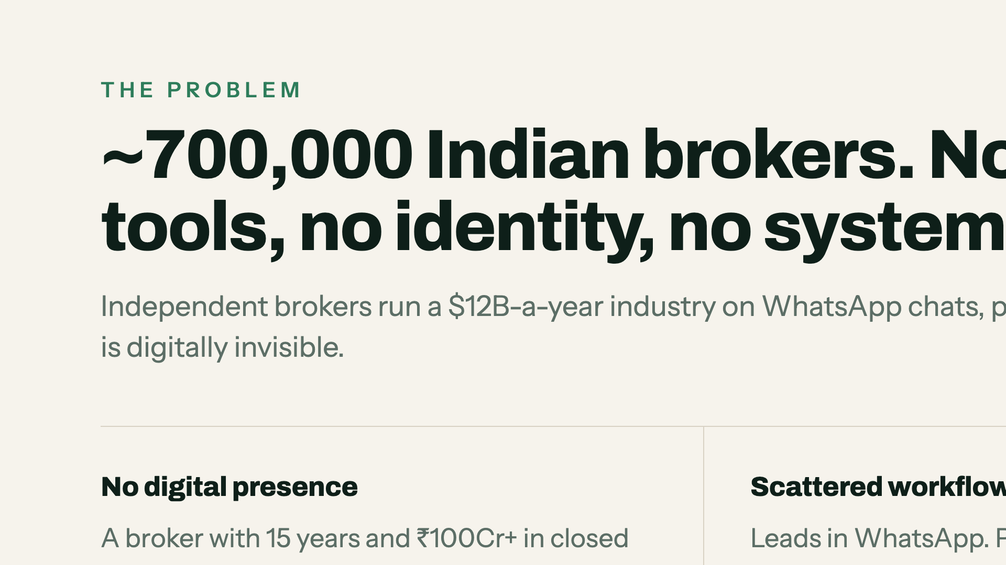
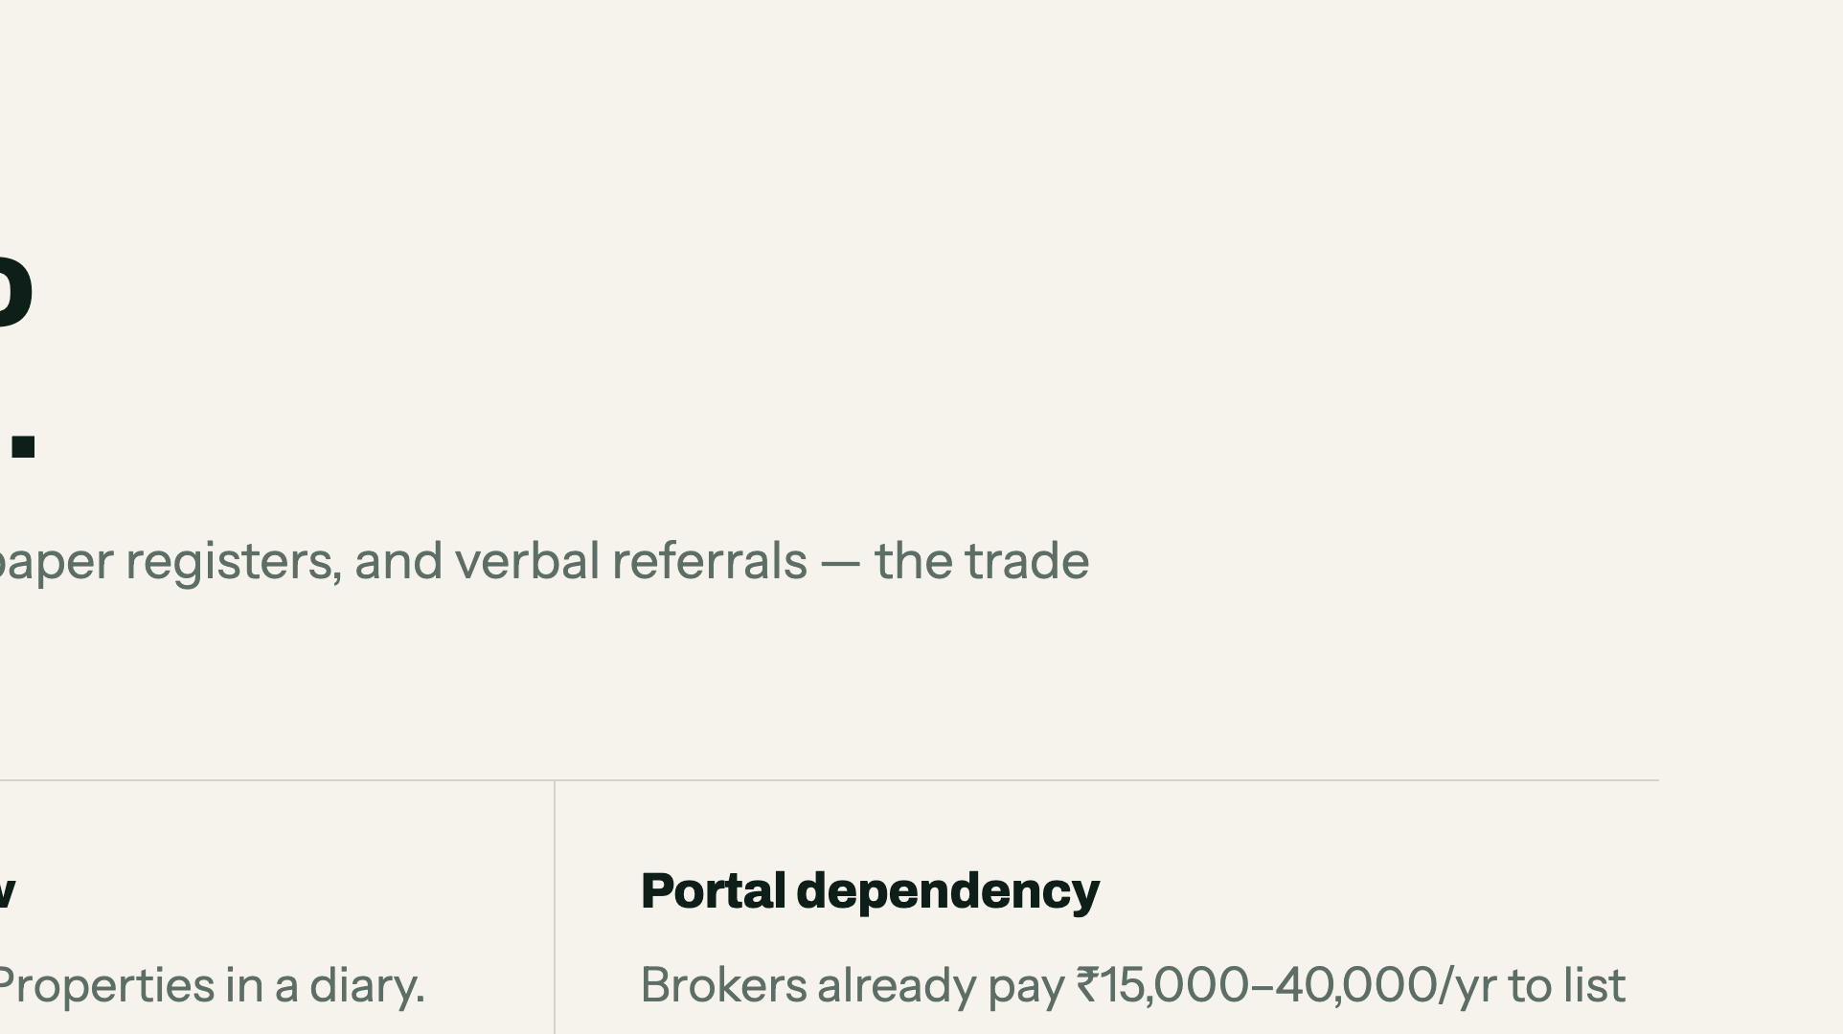
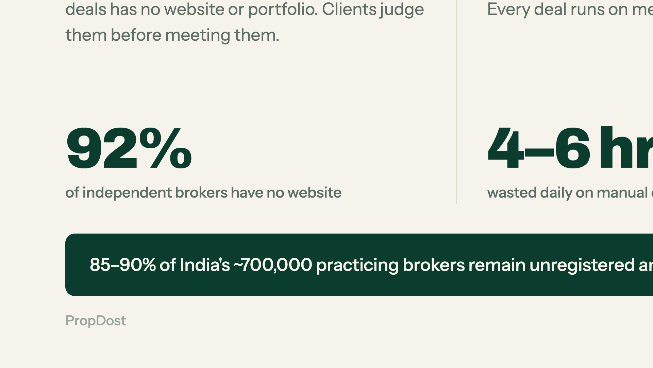
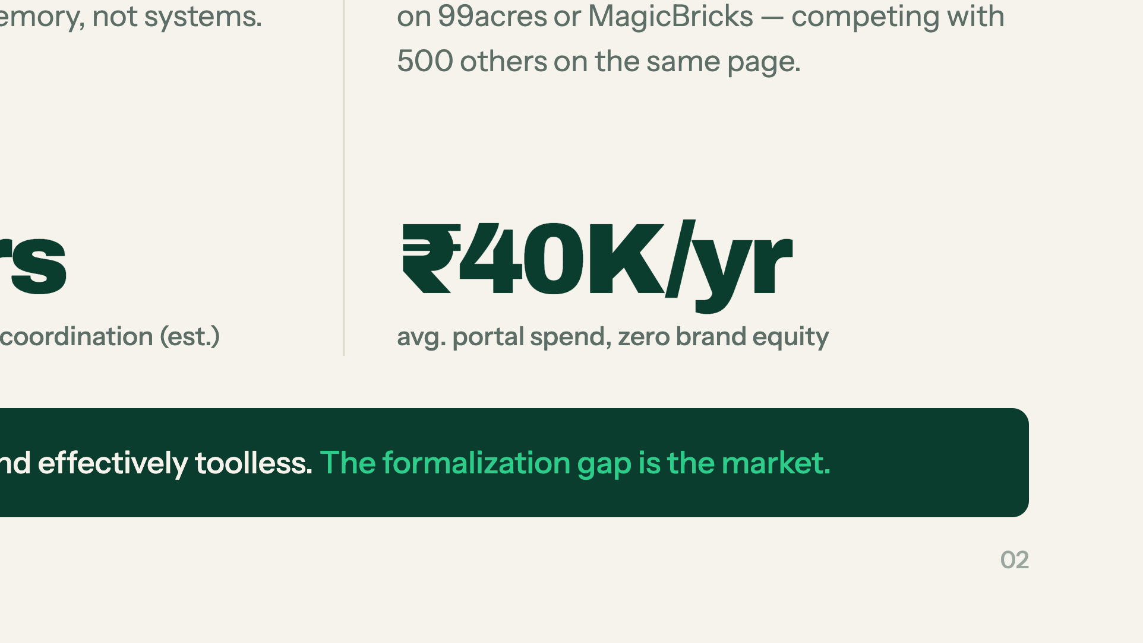
Notes:
700,000 brokers, no tools. Lead with the 92% stat — it lands hardest. Do not read all three columns; pick one.

Slide 3
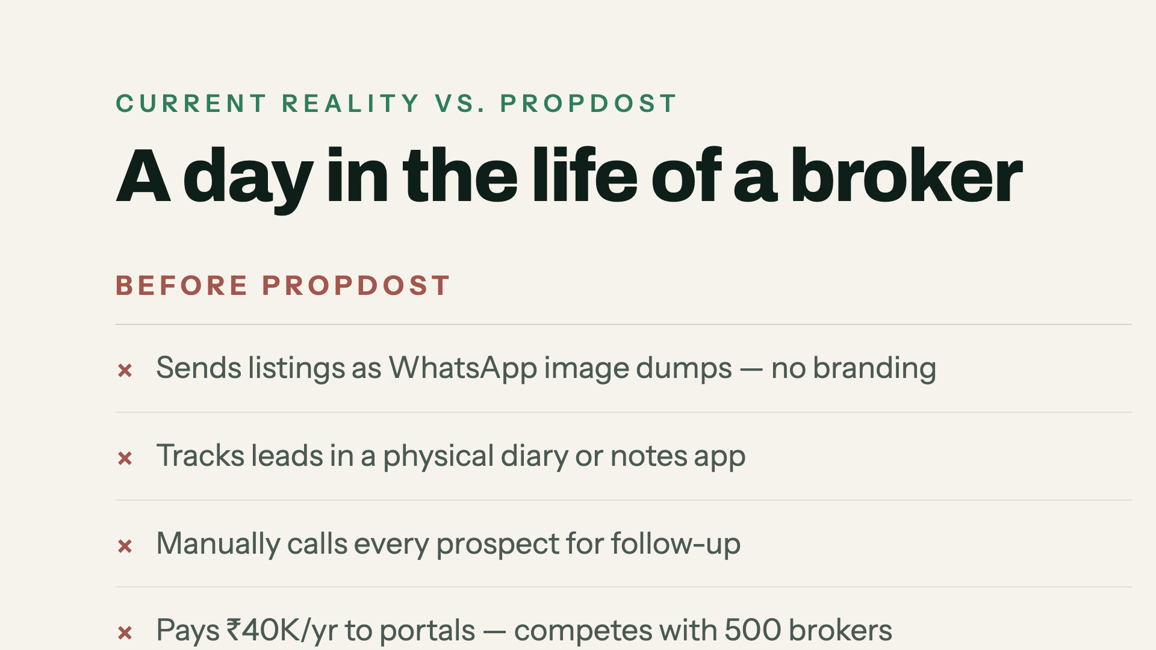
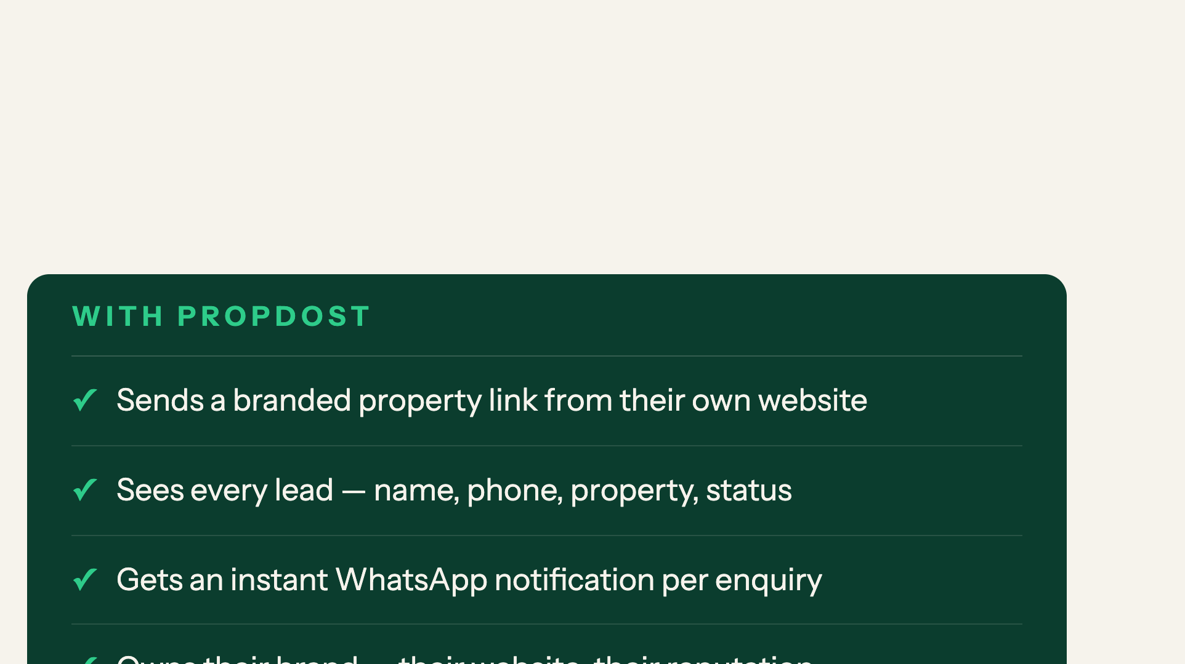
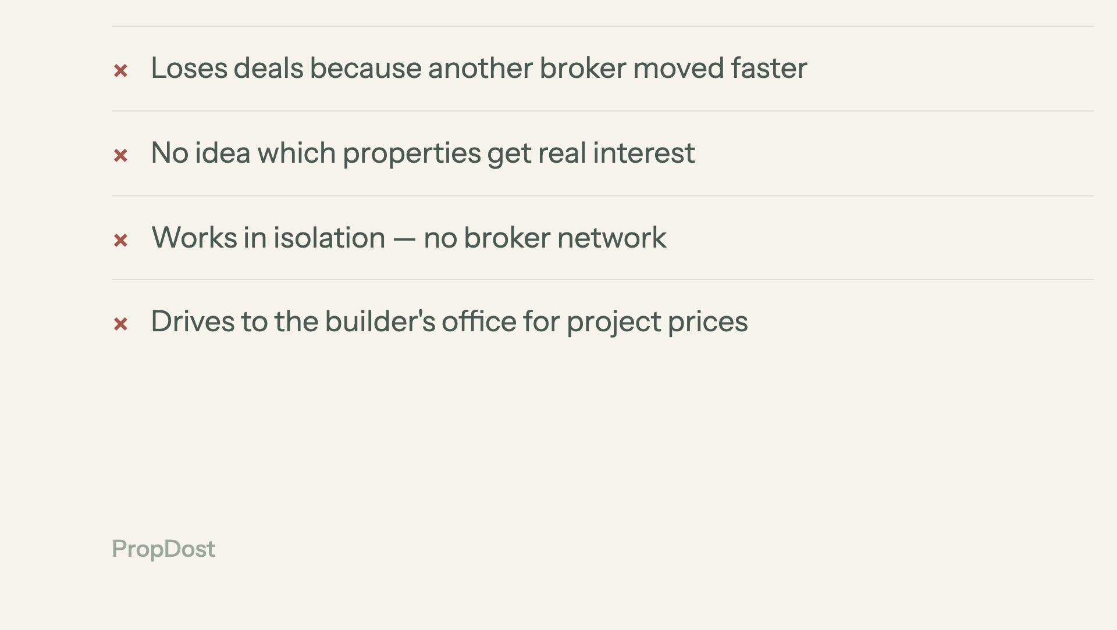
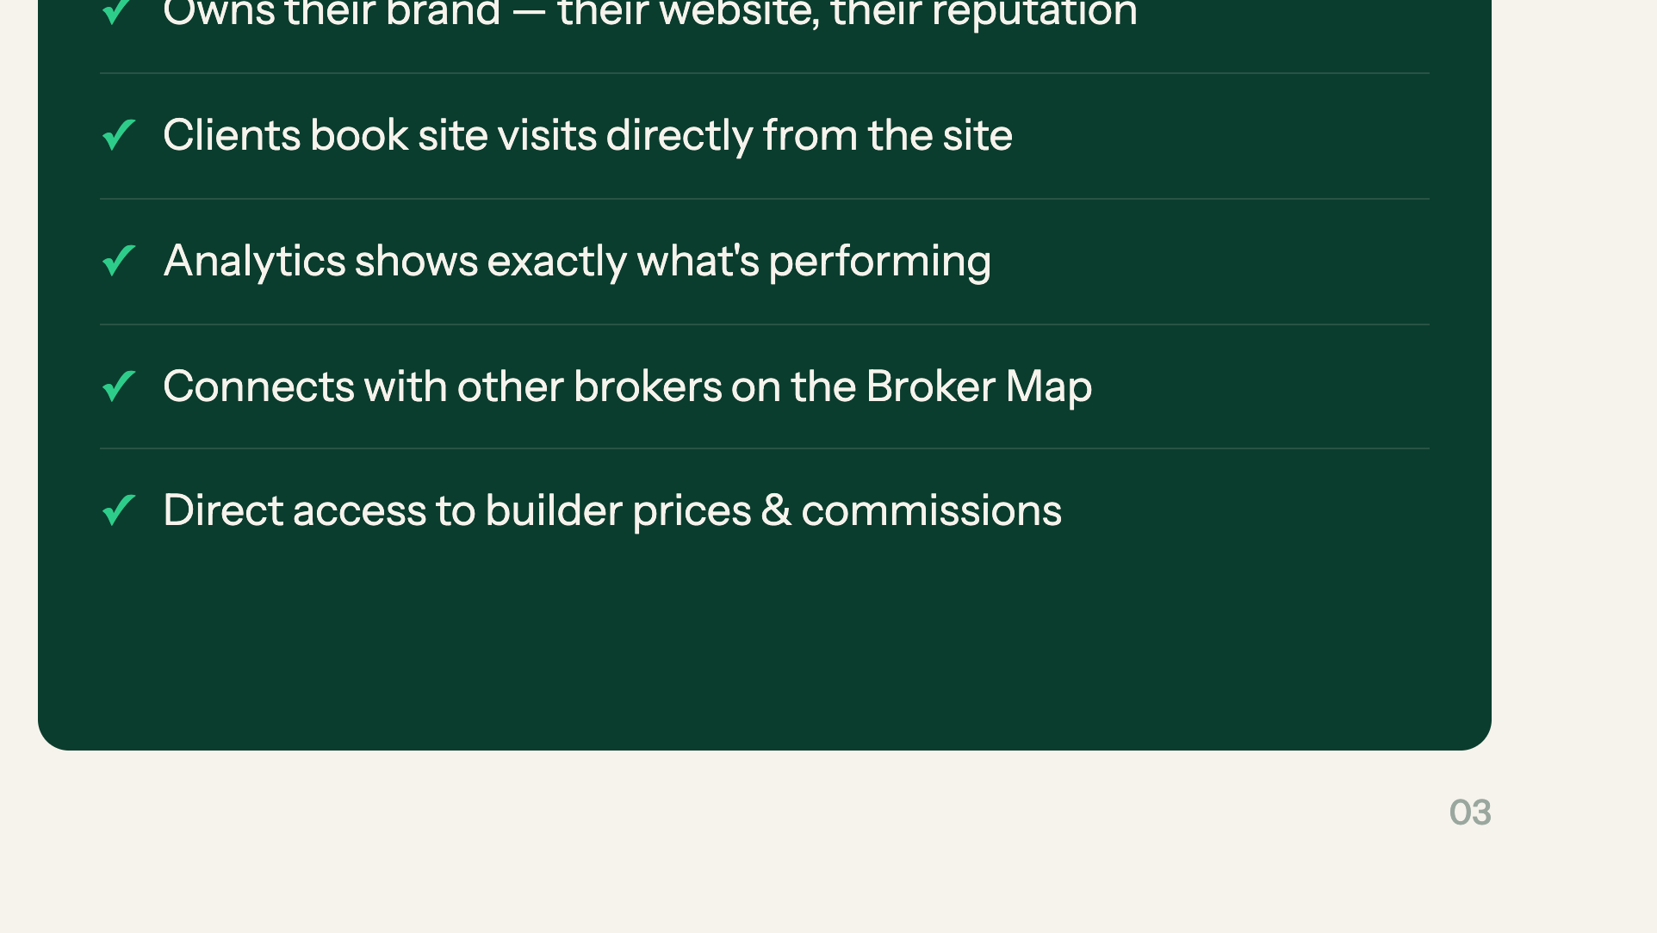
Notes:
Do not read this. Say 'this is the day, before and after' and let them scan for five seconds.

Slide 4
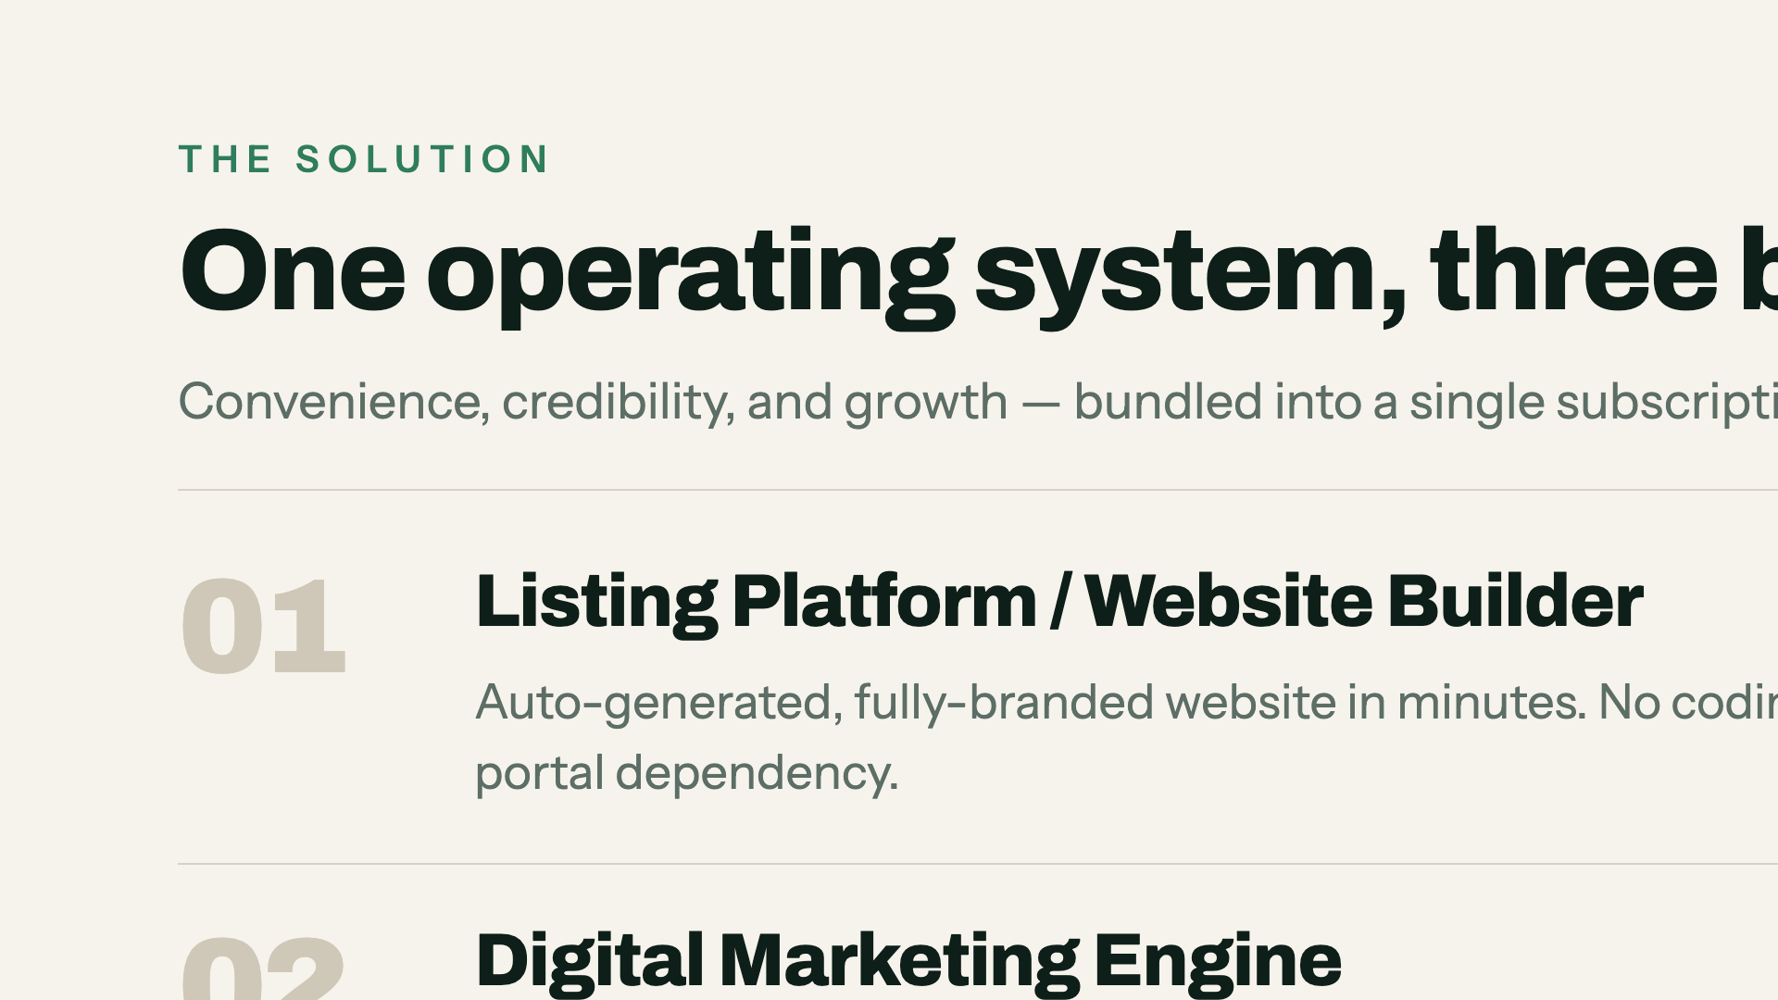
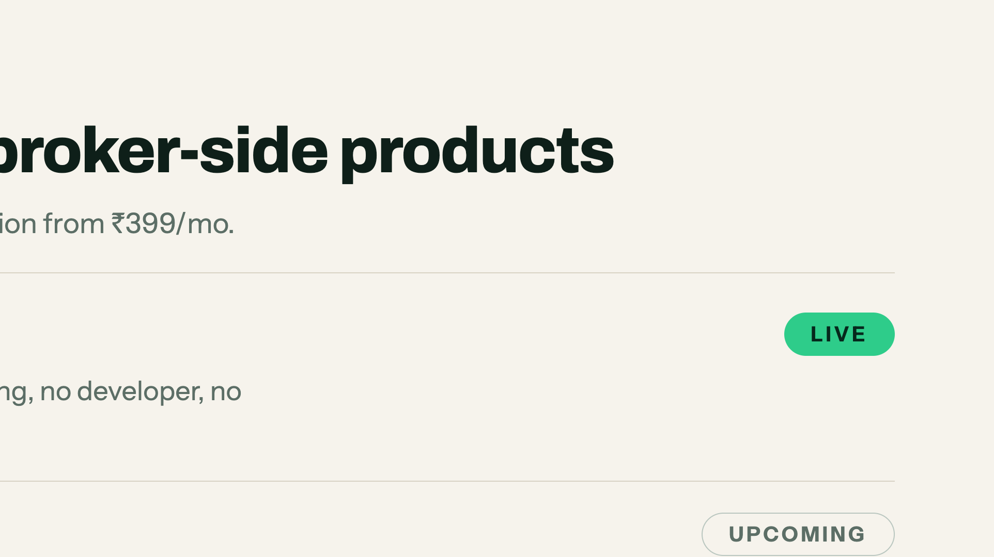
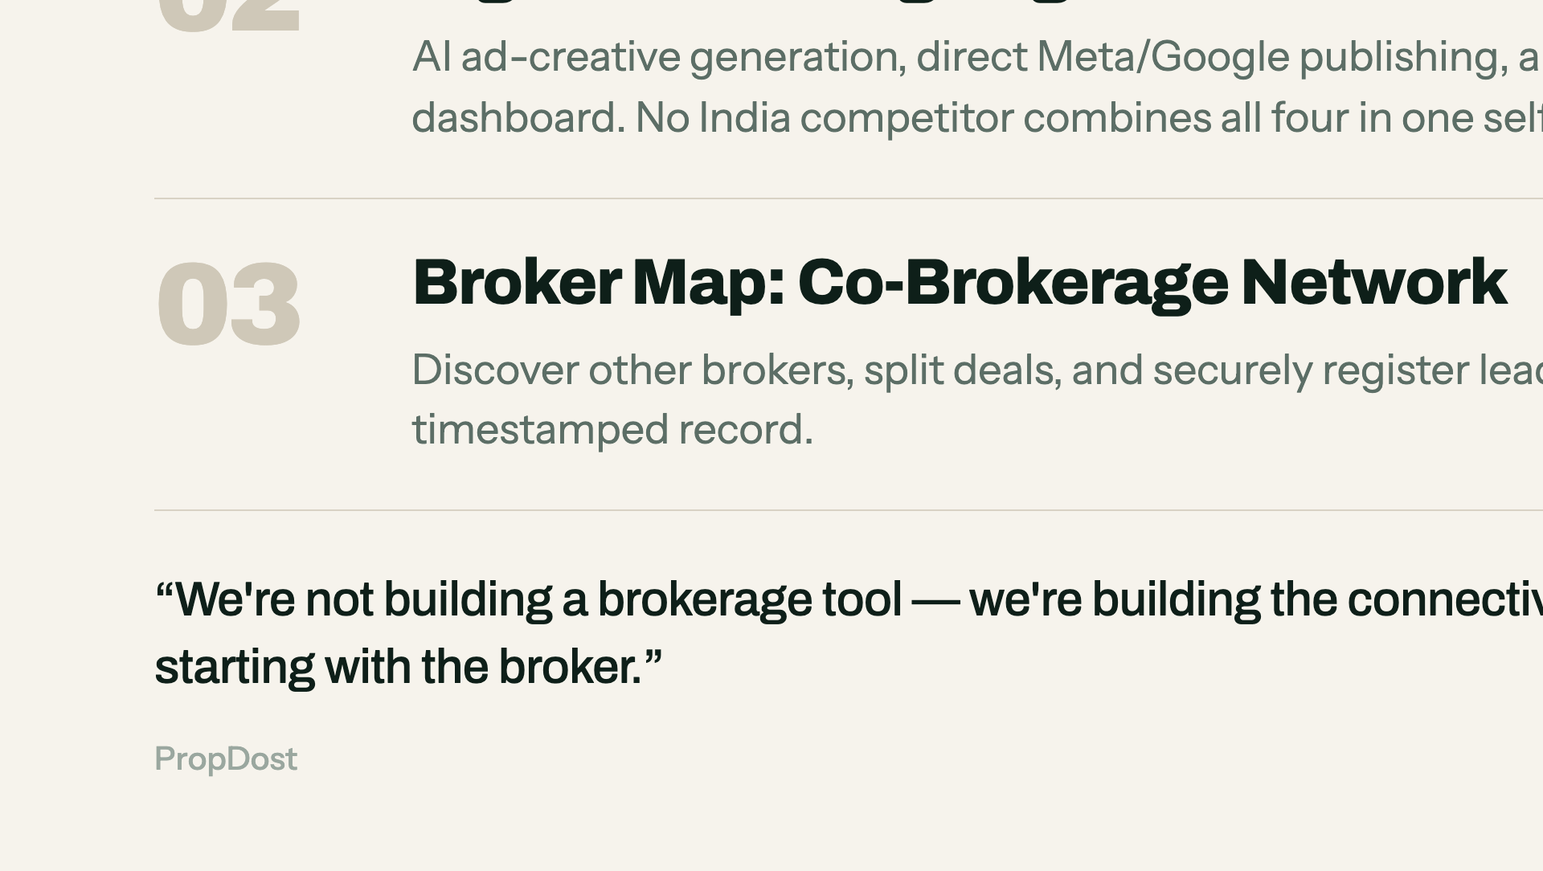
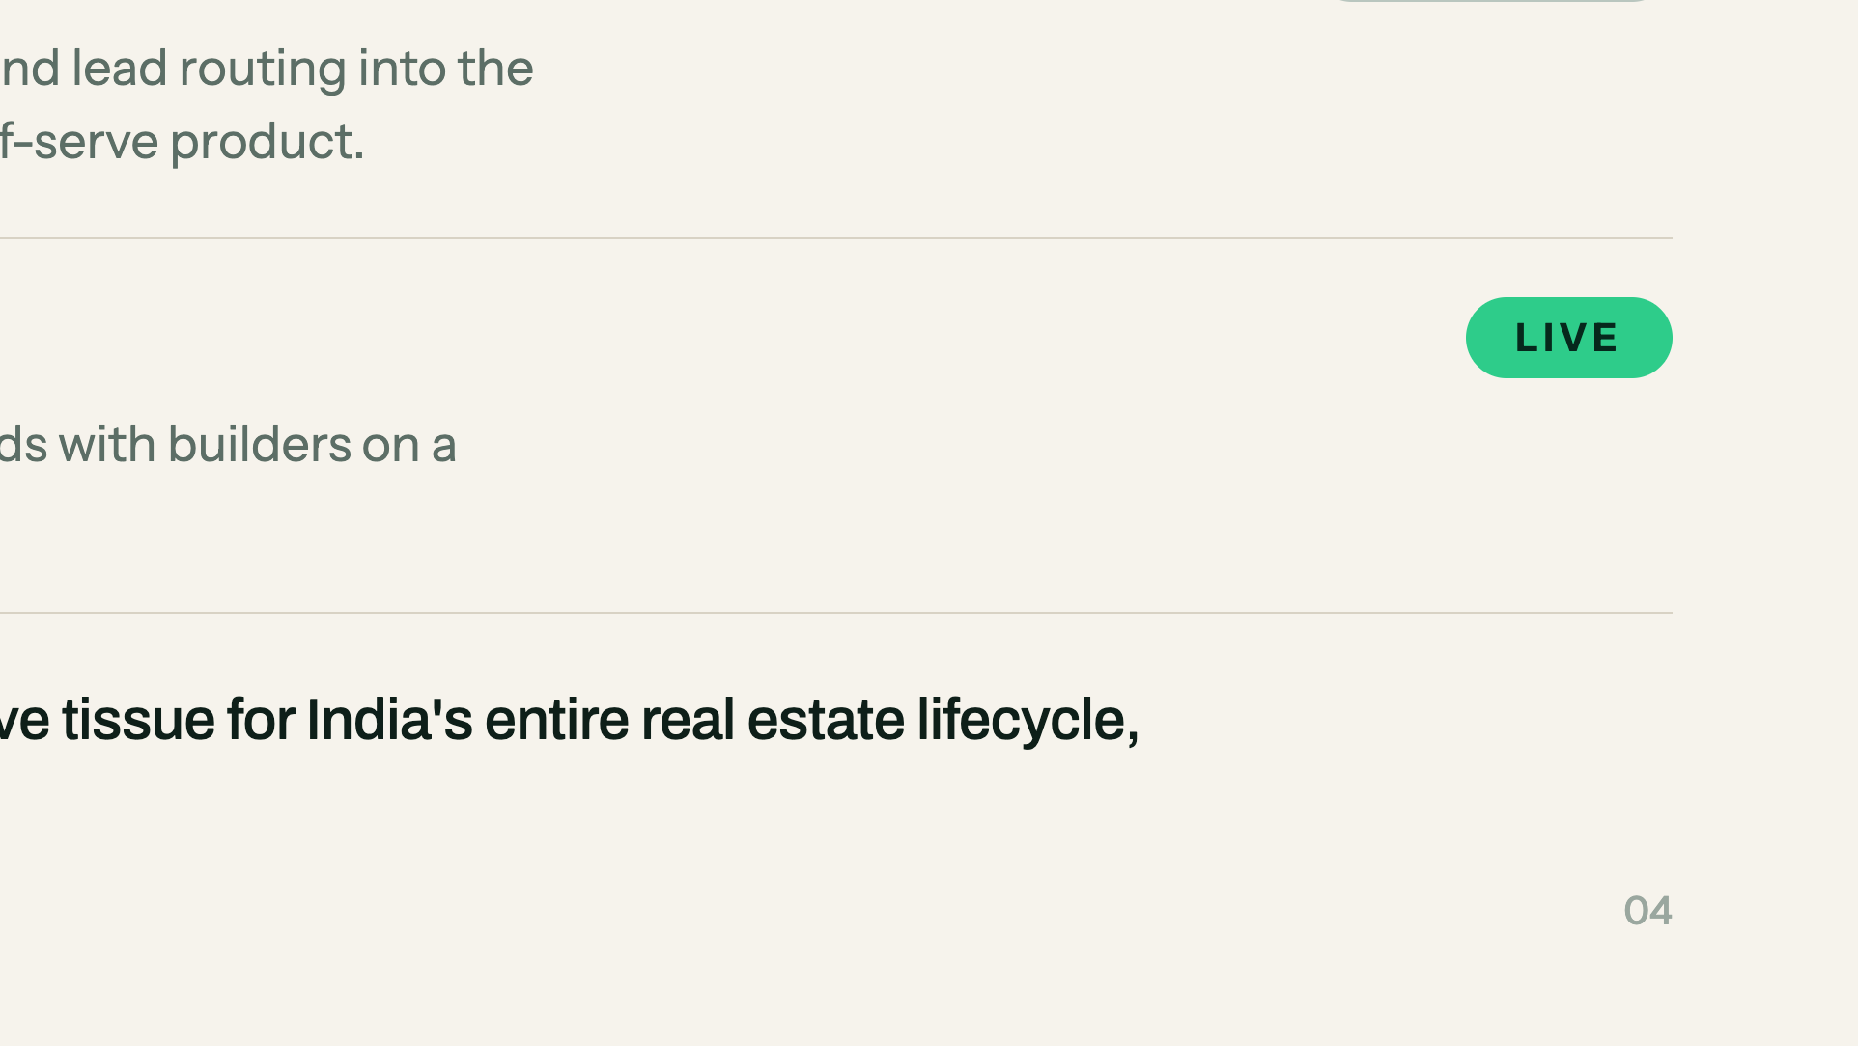
Notes:
Three products, one subscription. Say which two are live TODAY and which one is next. Land the quote.

Slide 5
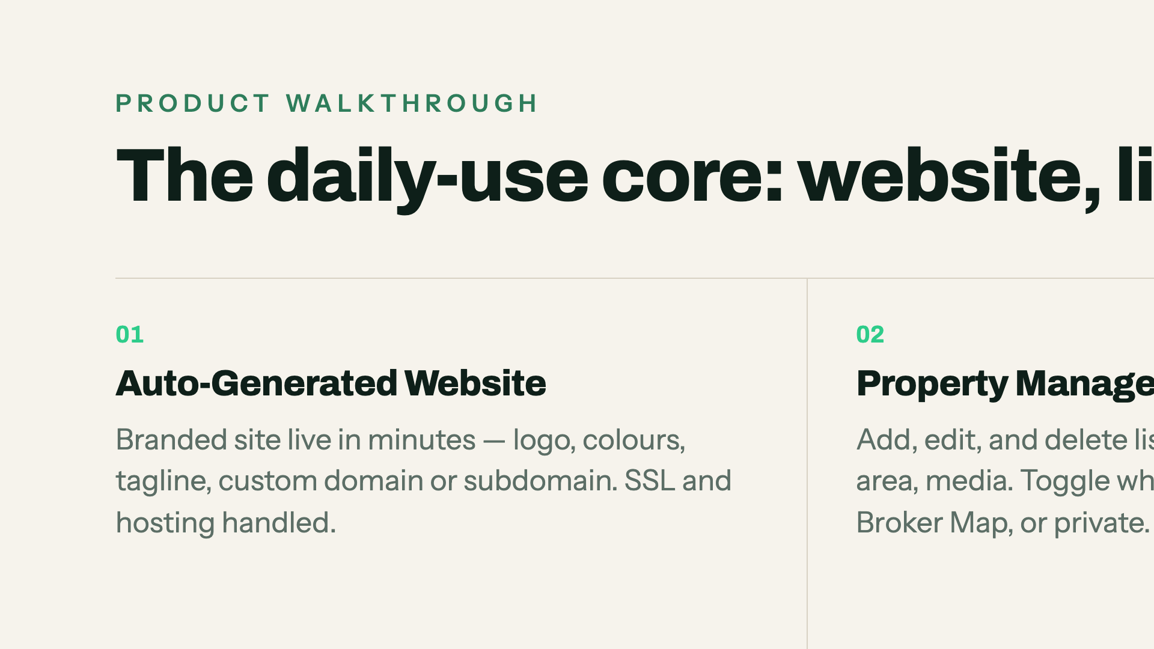
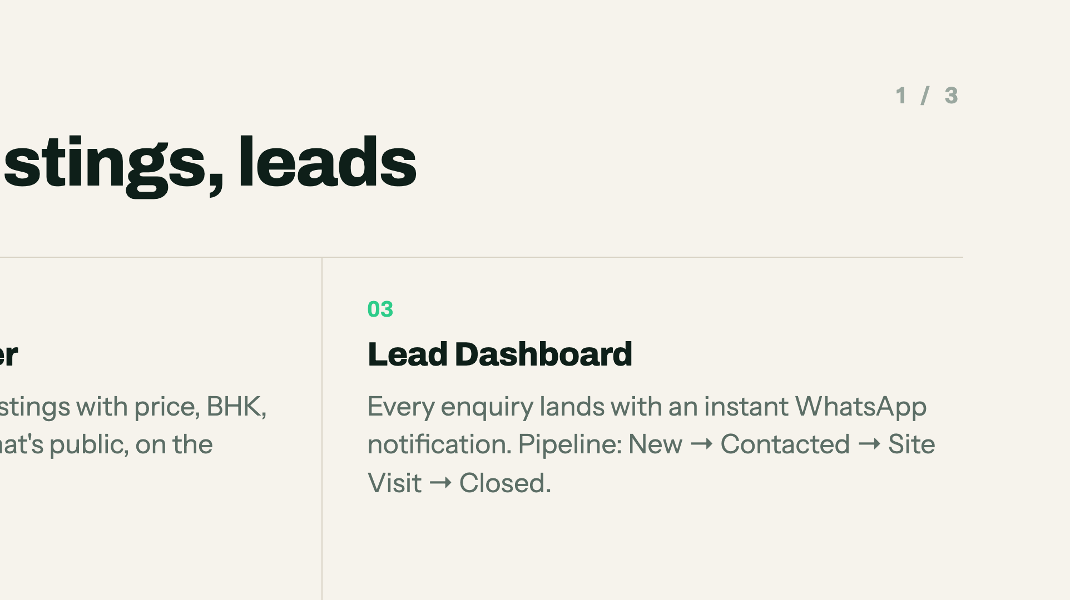
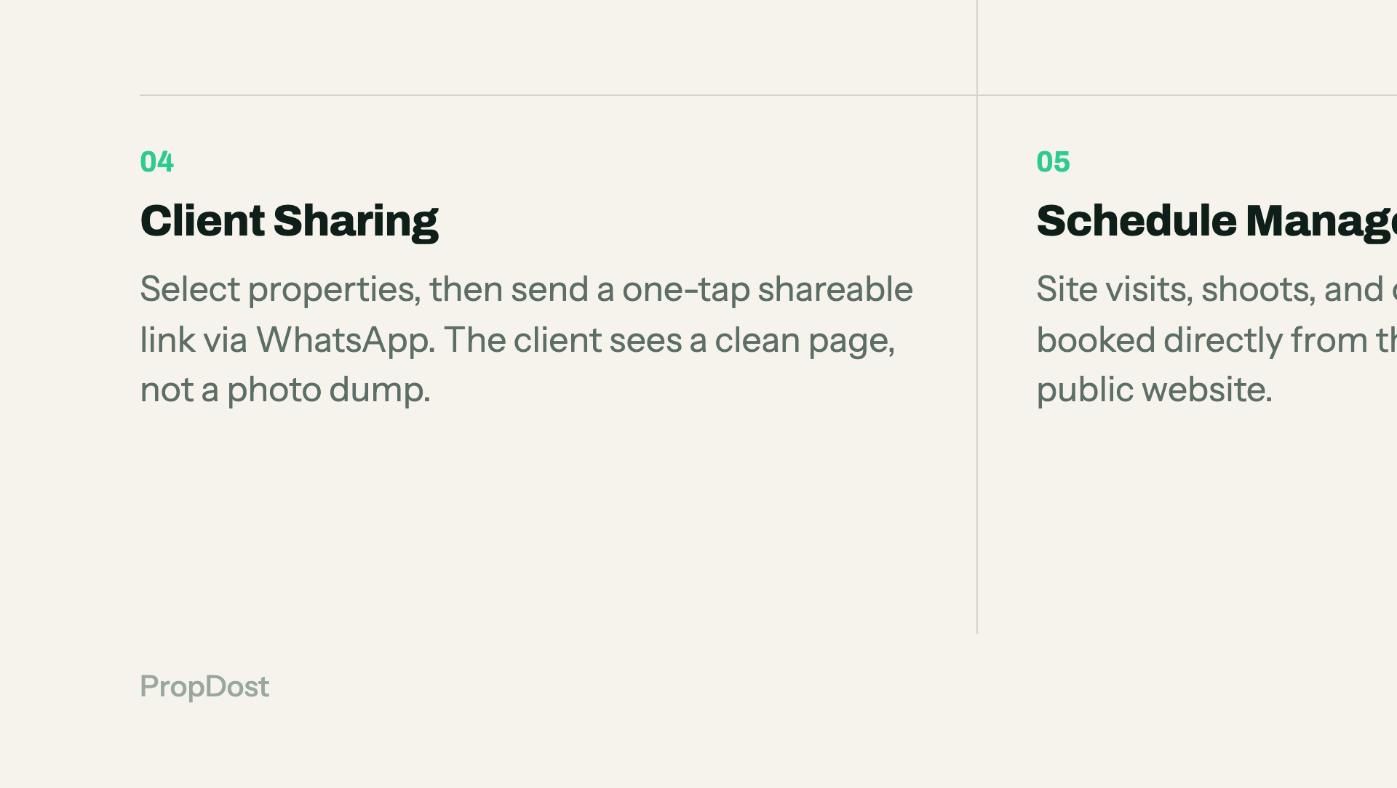
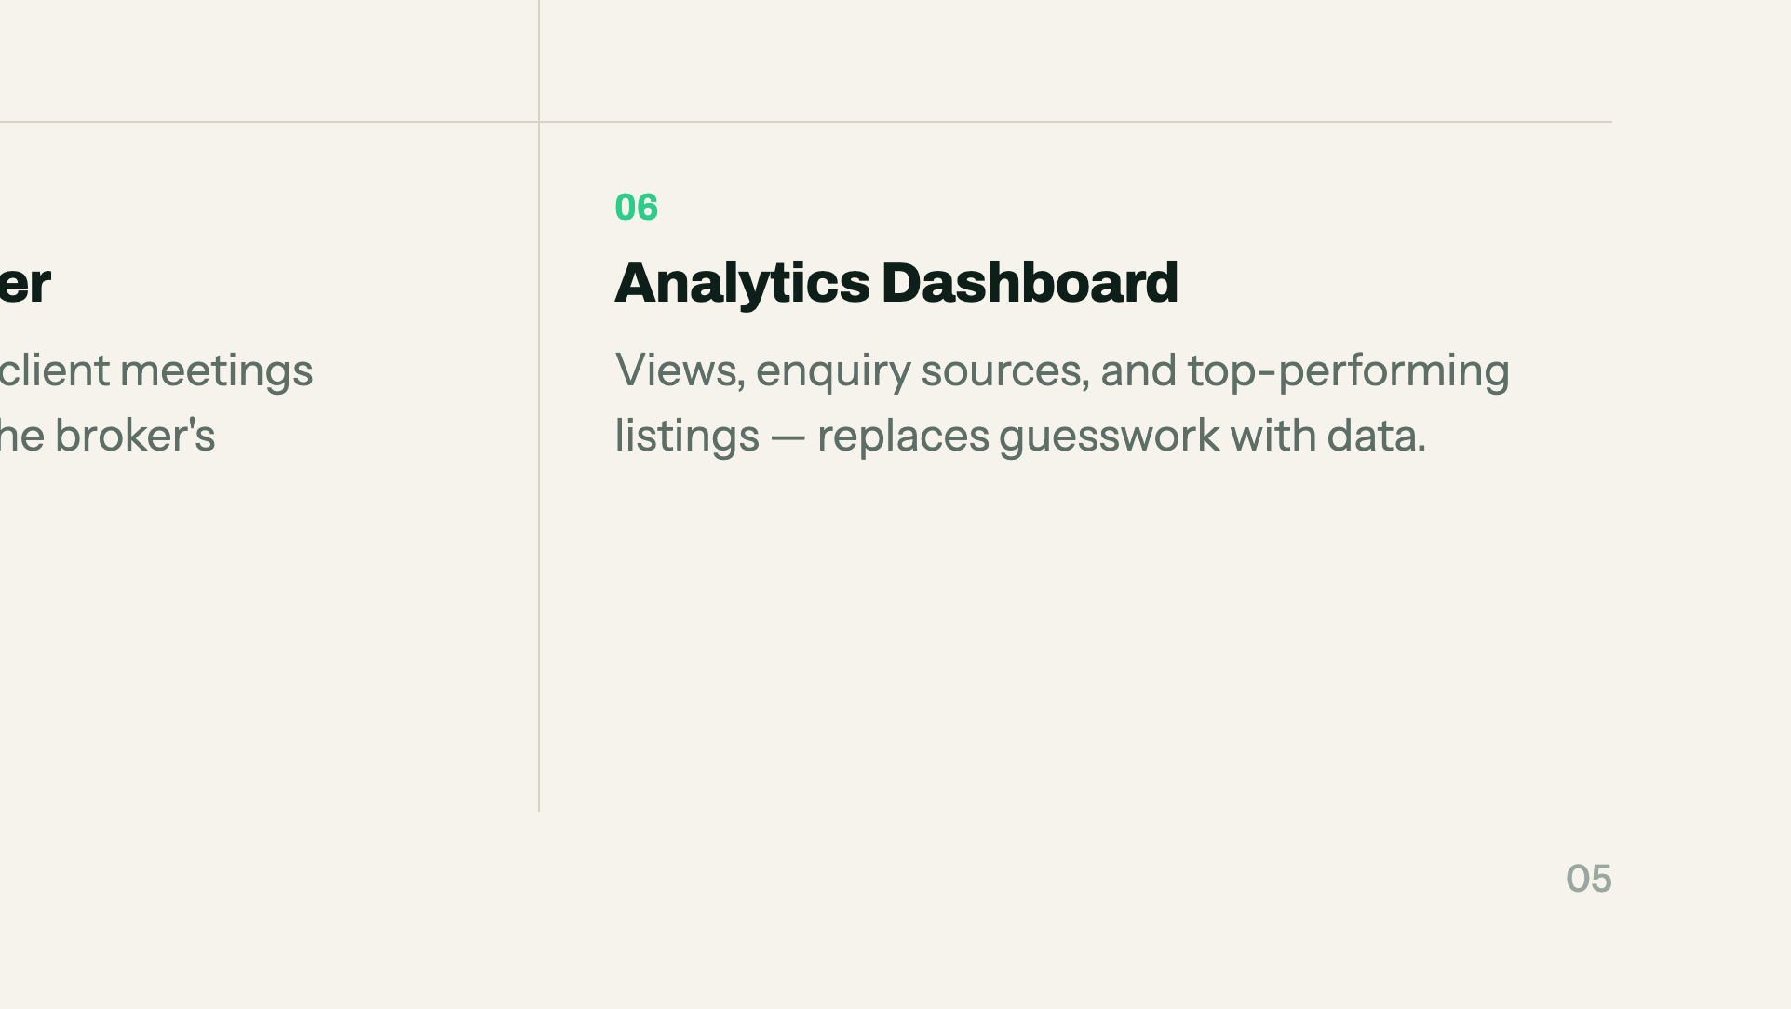
Notes:
Walkthrough 1 of 3. Name two features and move — the grid does the rest.

Slide 6
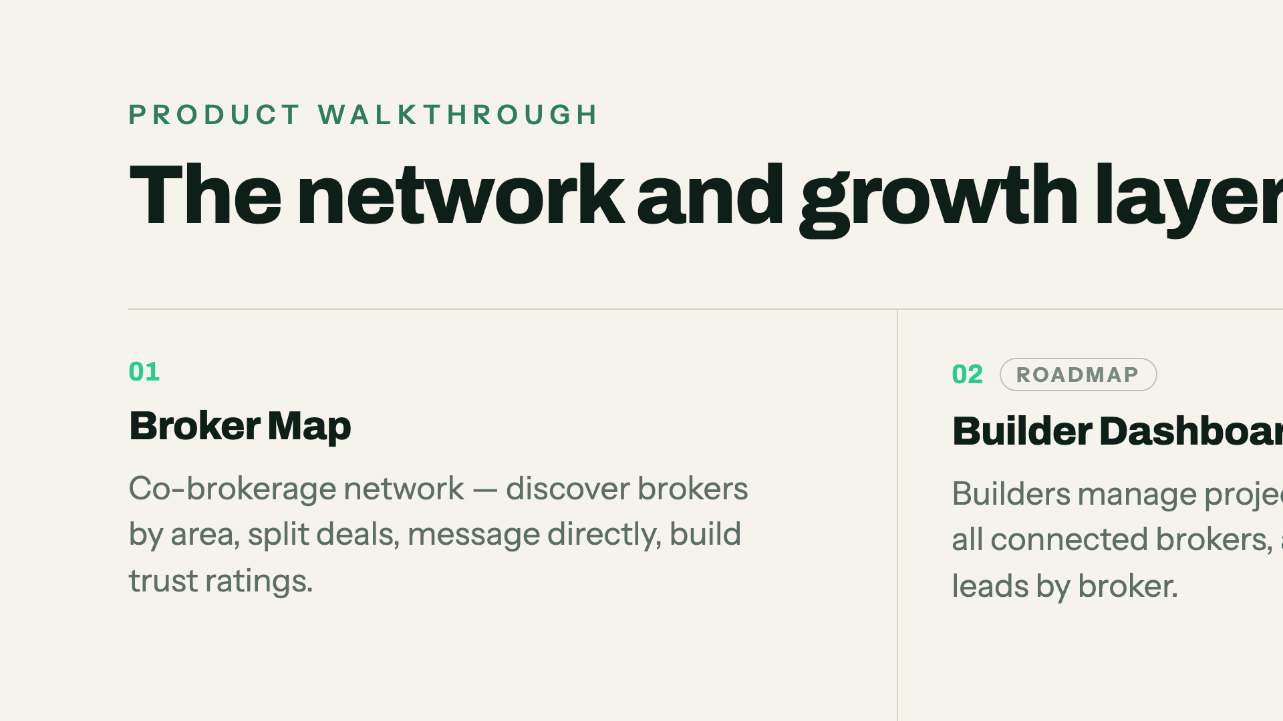
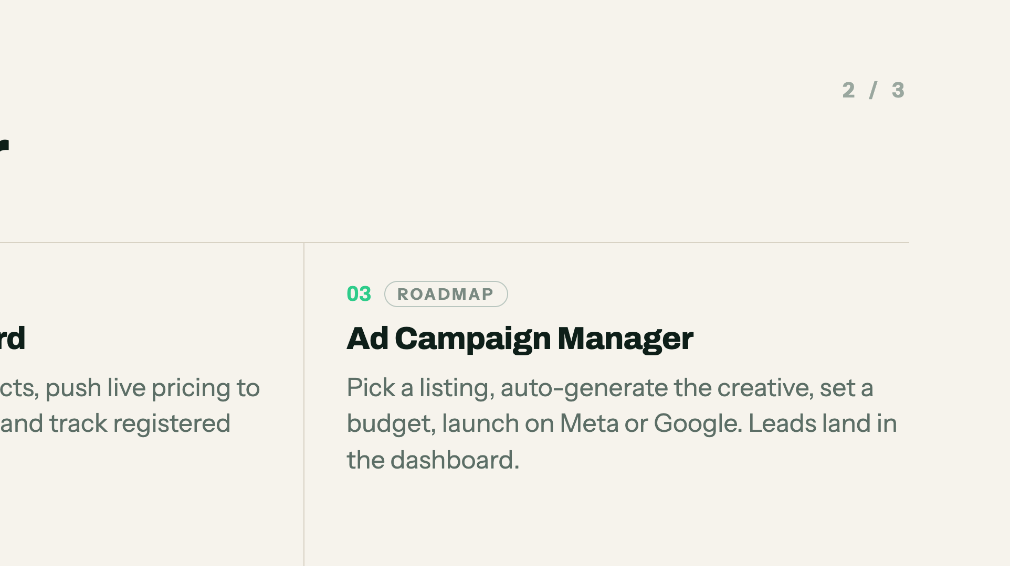
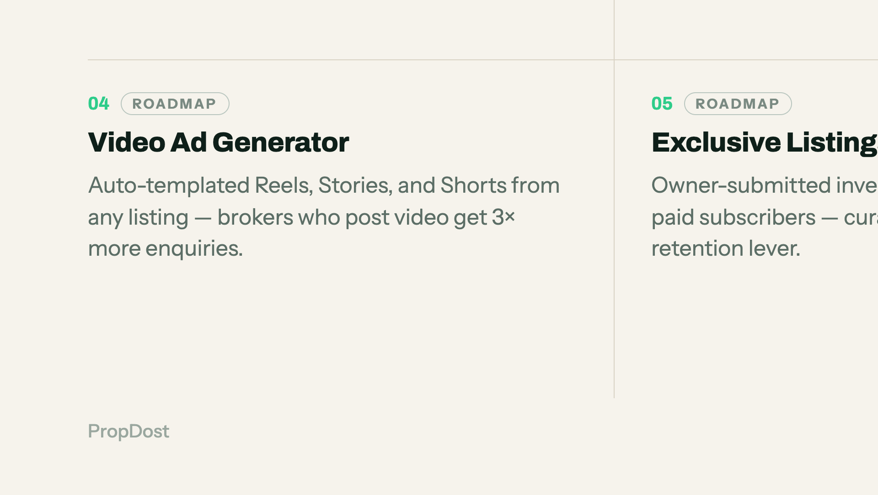
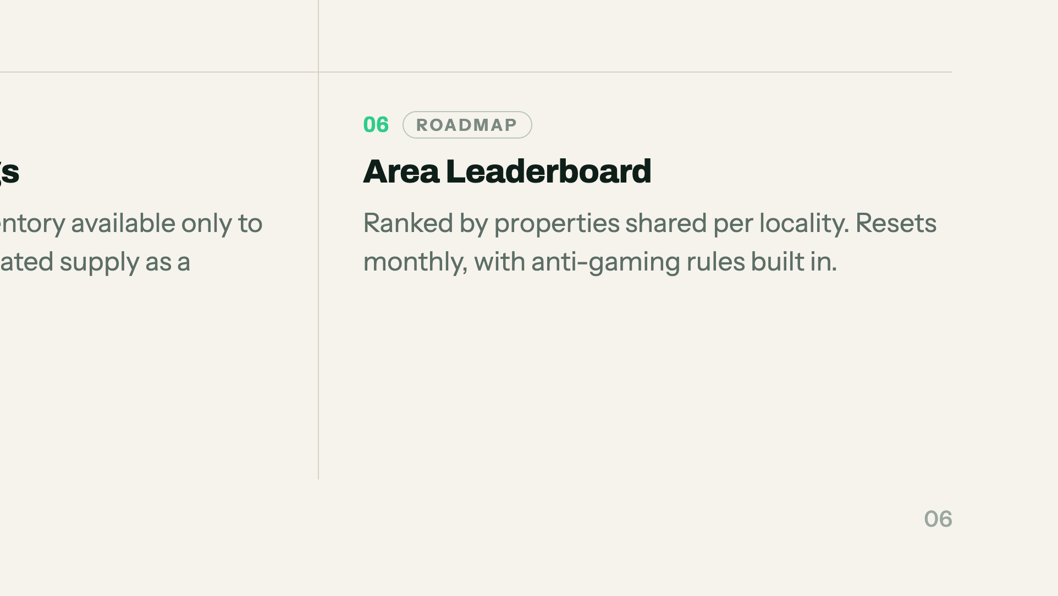
Notes:
The network layer. Broker Map and Builder Dashboard are the two that matter to an investor — the rest are retention.

Slide 7
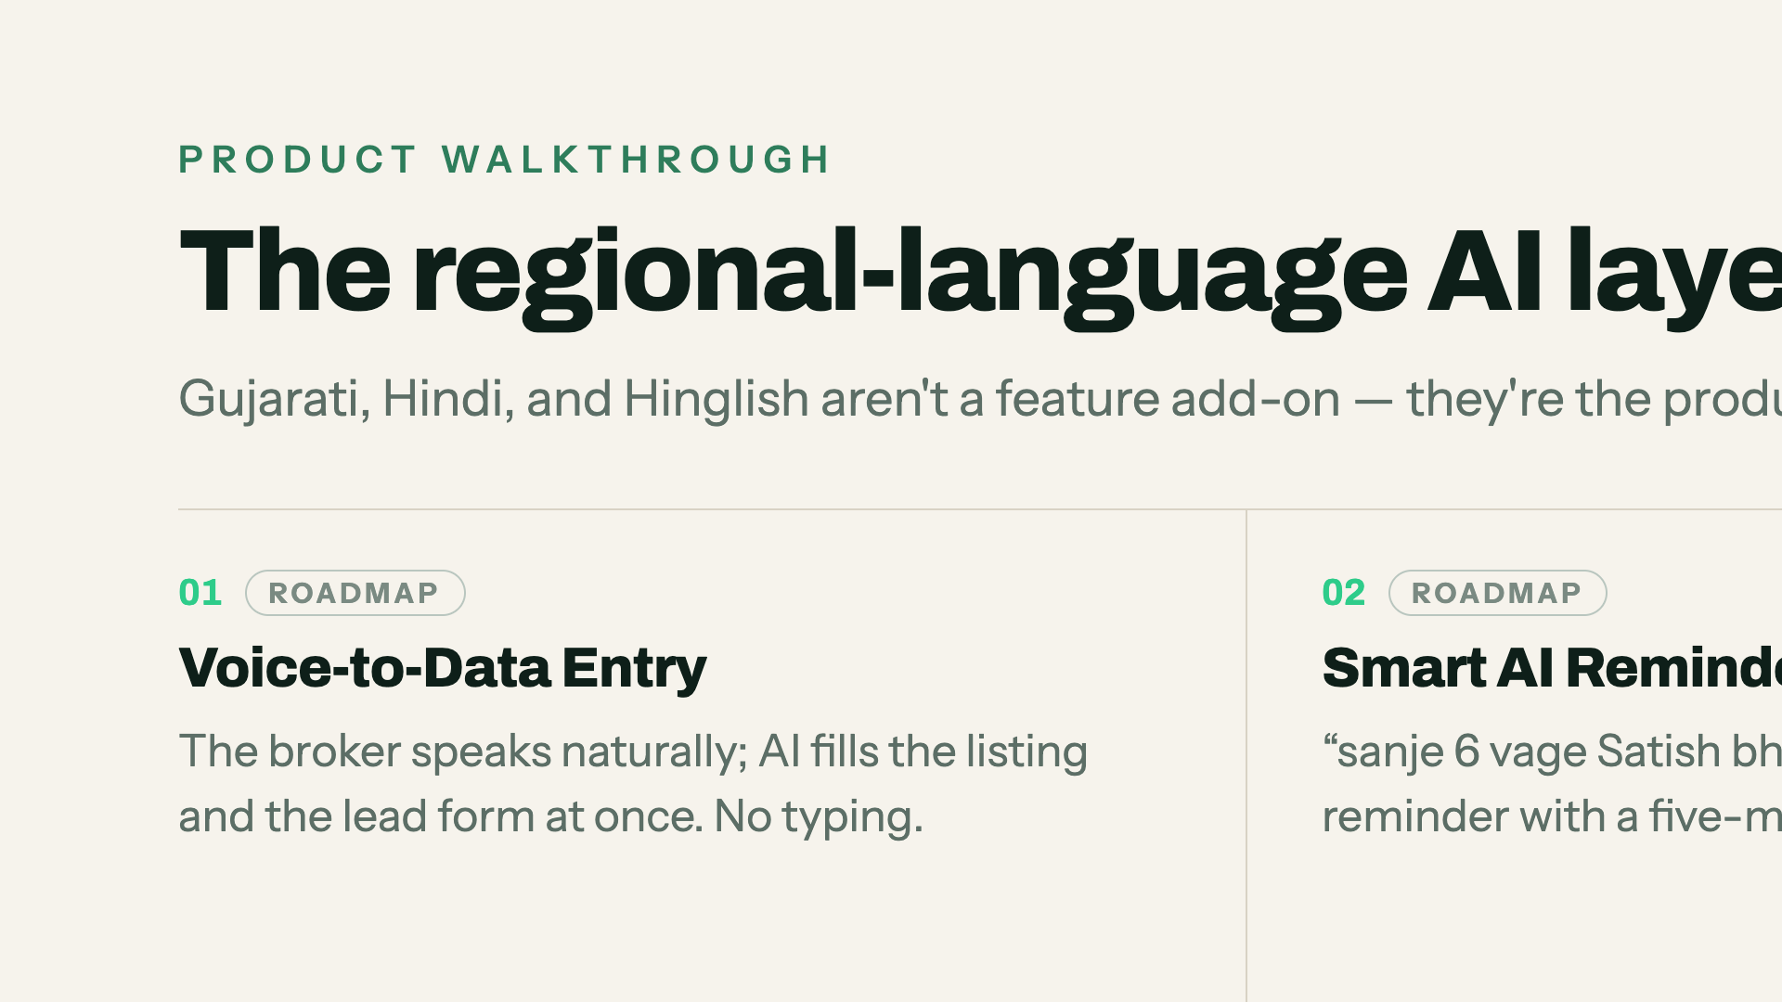
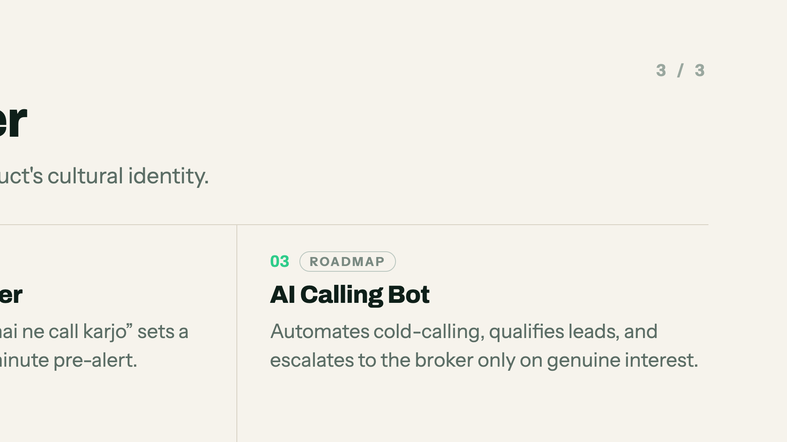
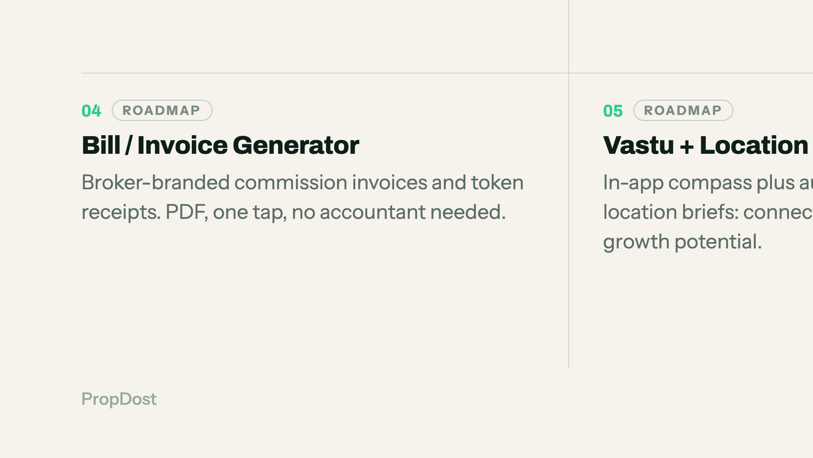
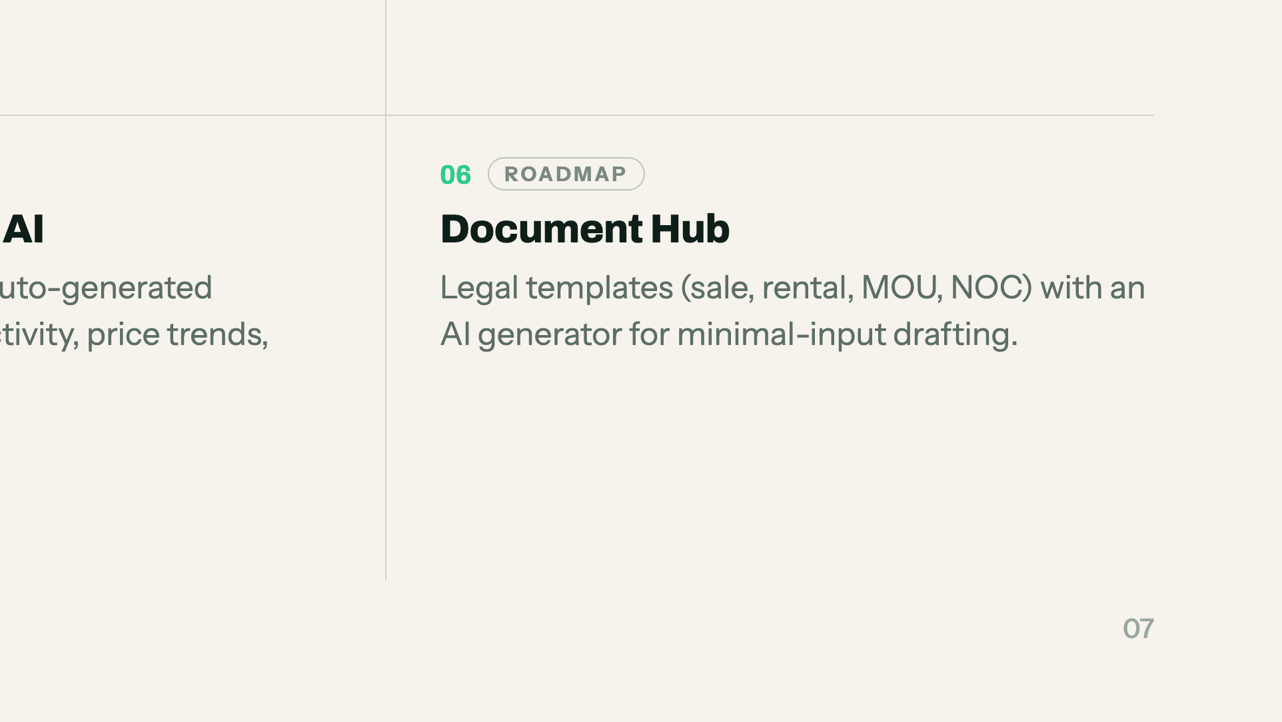
Notes:
This is the differentiation slide. Say the Gujarati reminder line out loud — it is the moment the room understands the product.

Slide 8
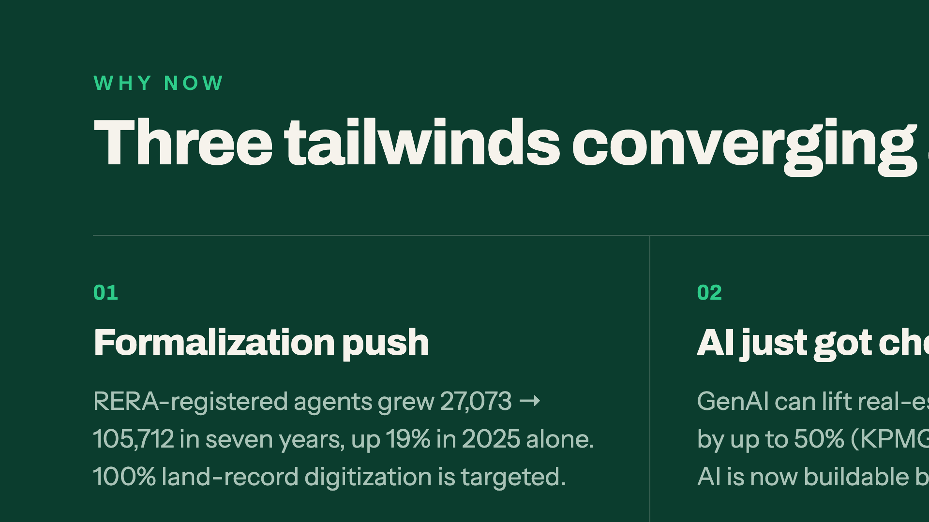
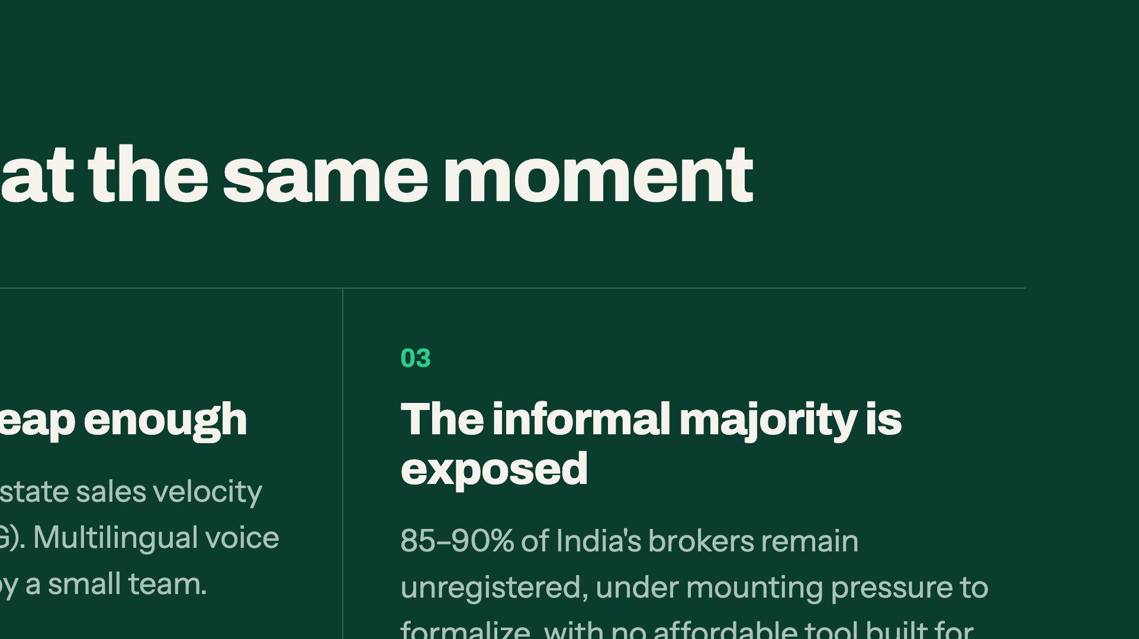
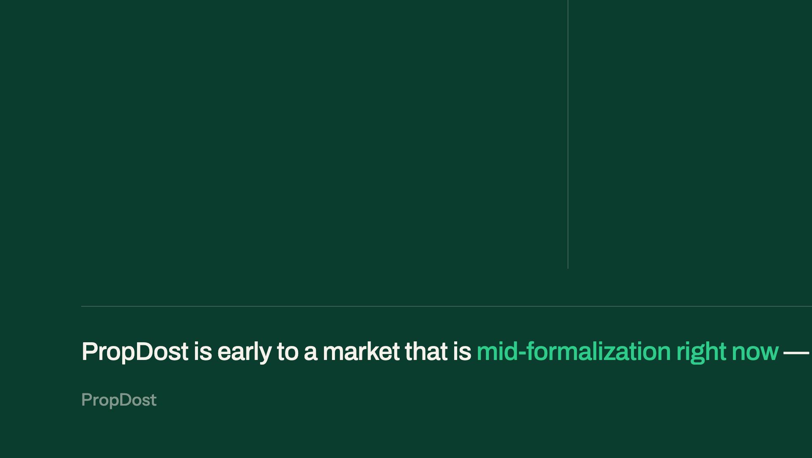
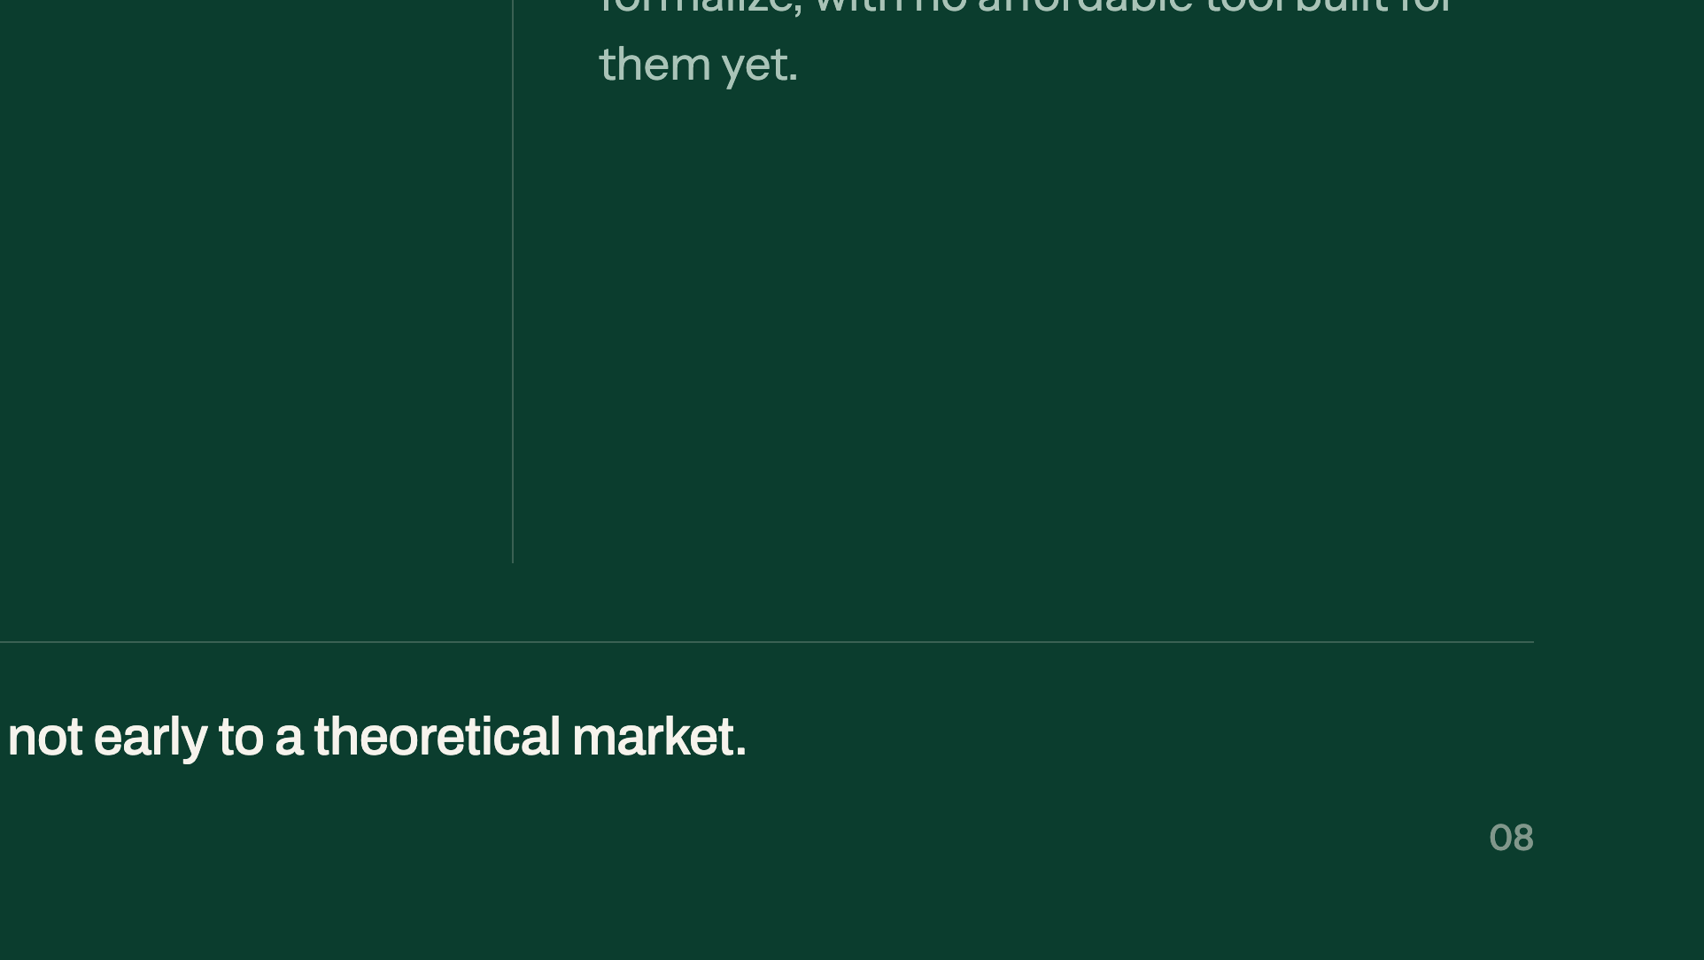
Notes:
Three tailwinds. The RERA number is the strongest — 27,073 to 105,712 in seven years.

Slide 9
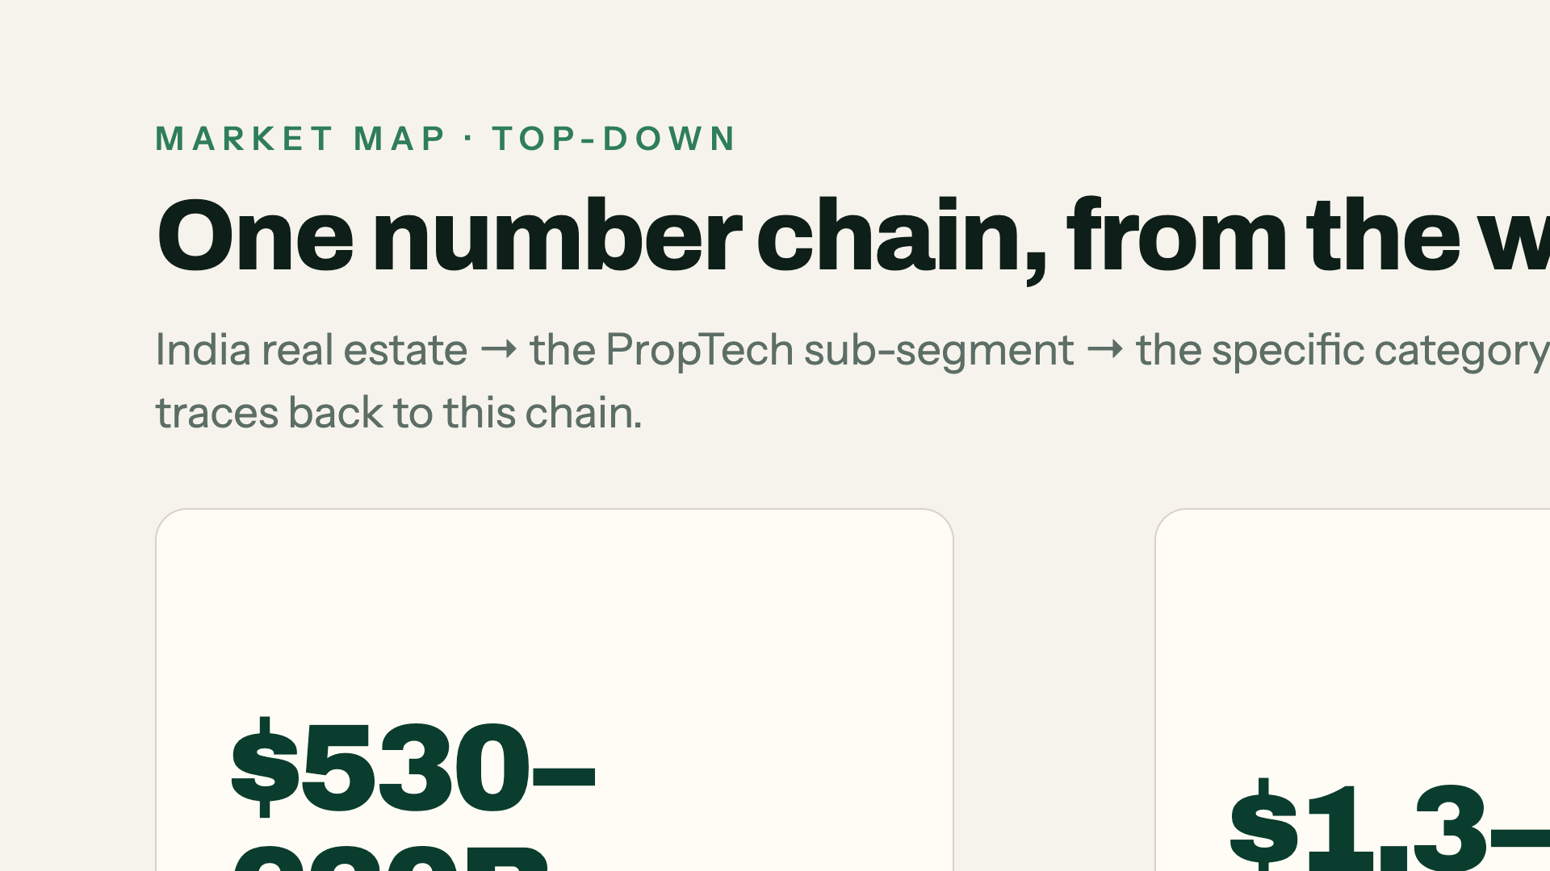
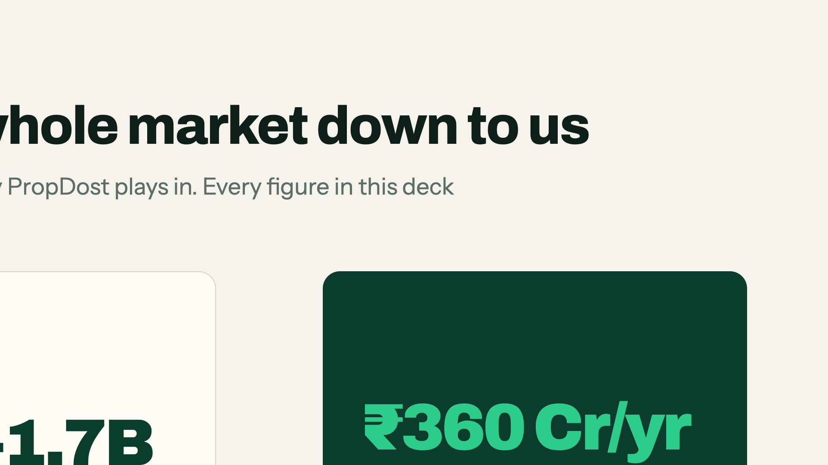
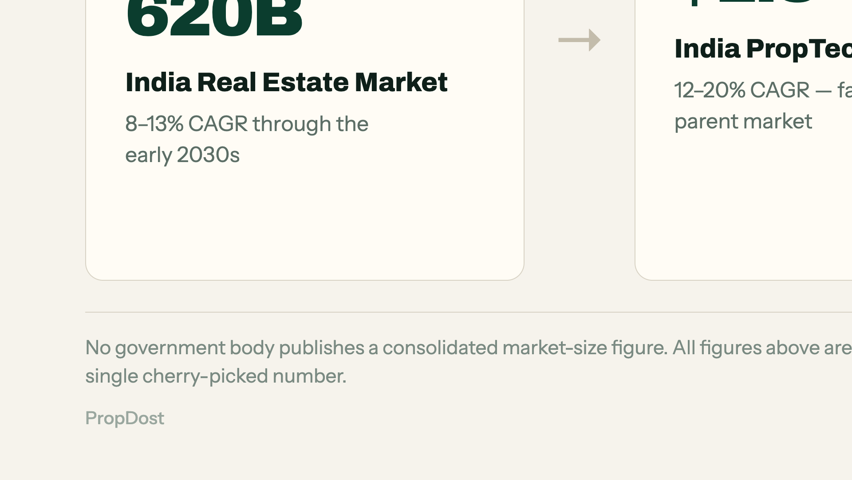
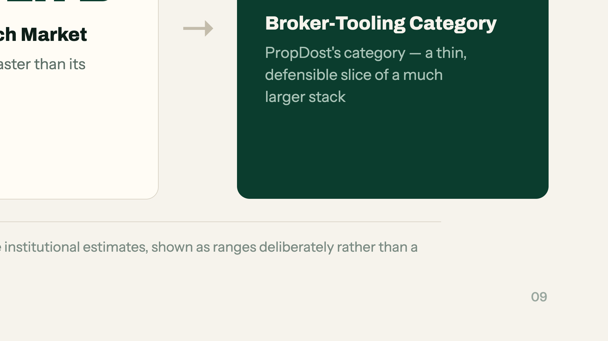
Notes:
One number chain. Point at the ₹360 Cr — that is the only figure that matters here.

Slide 10
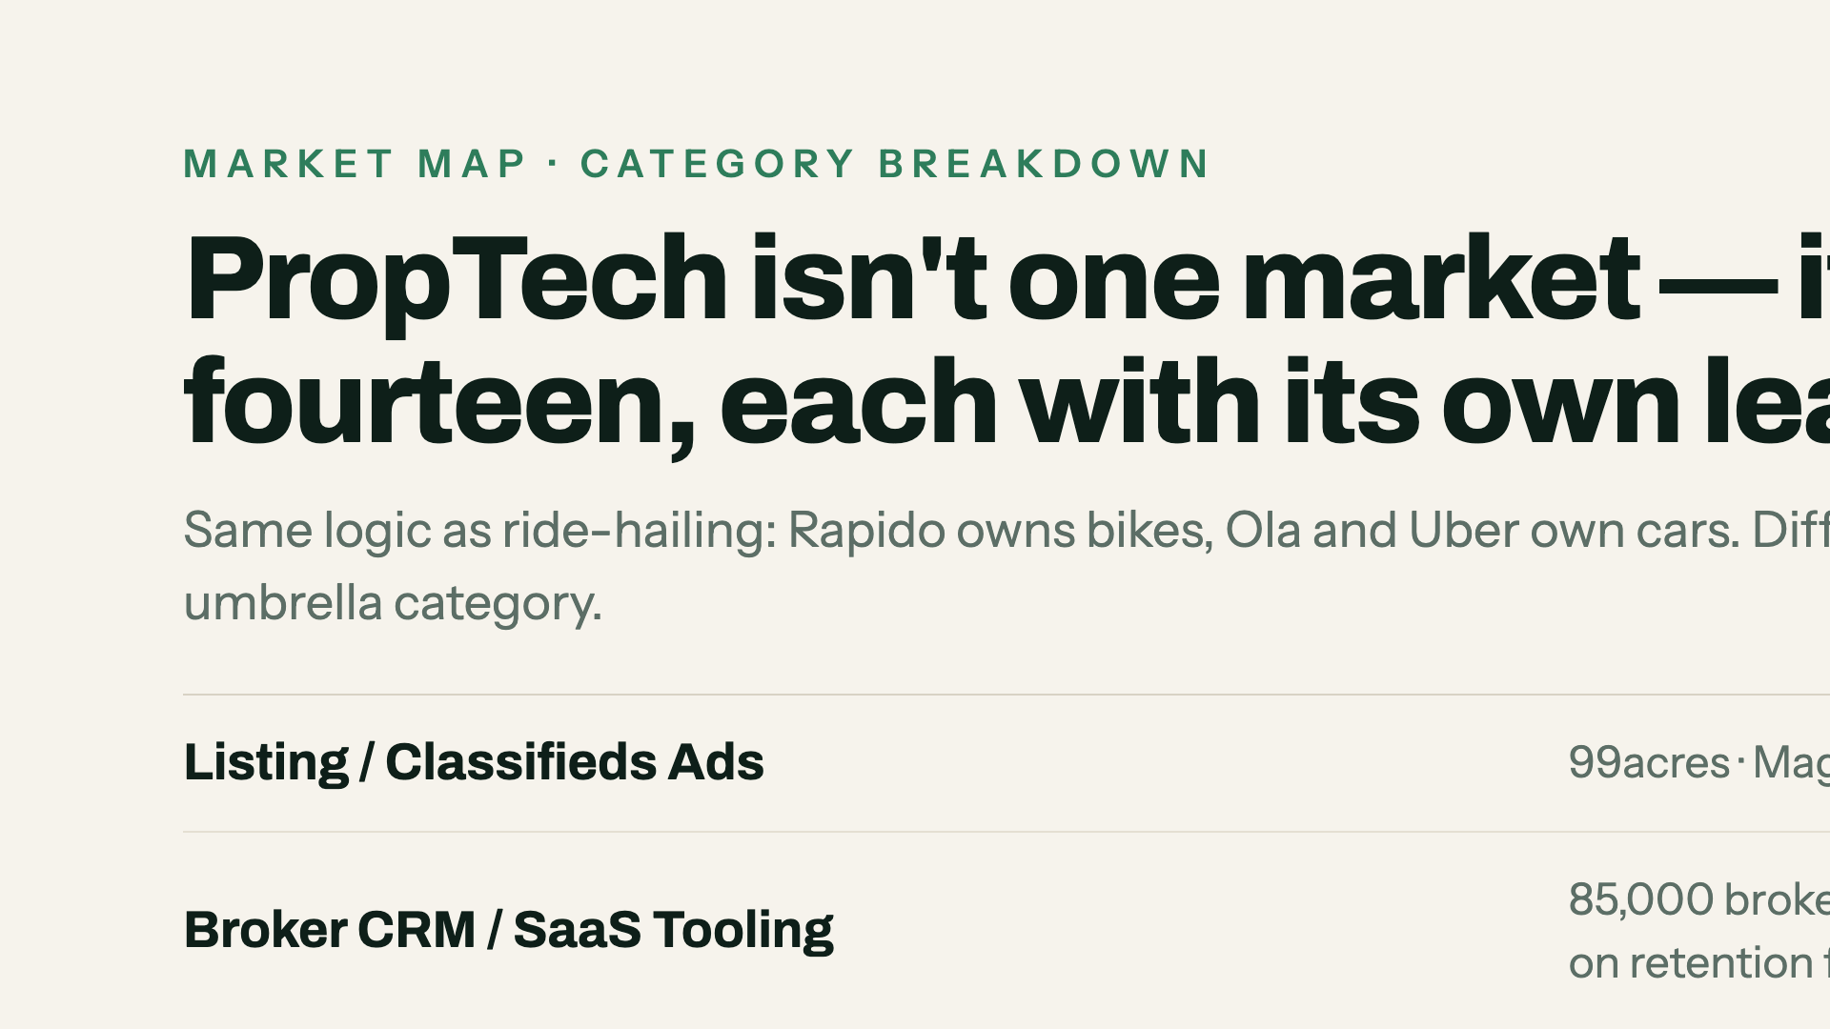
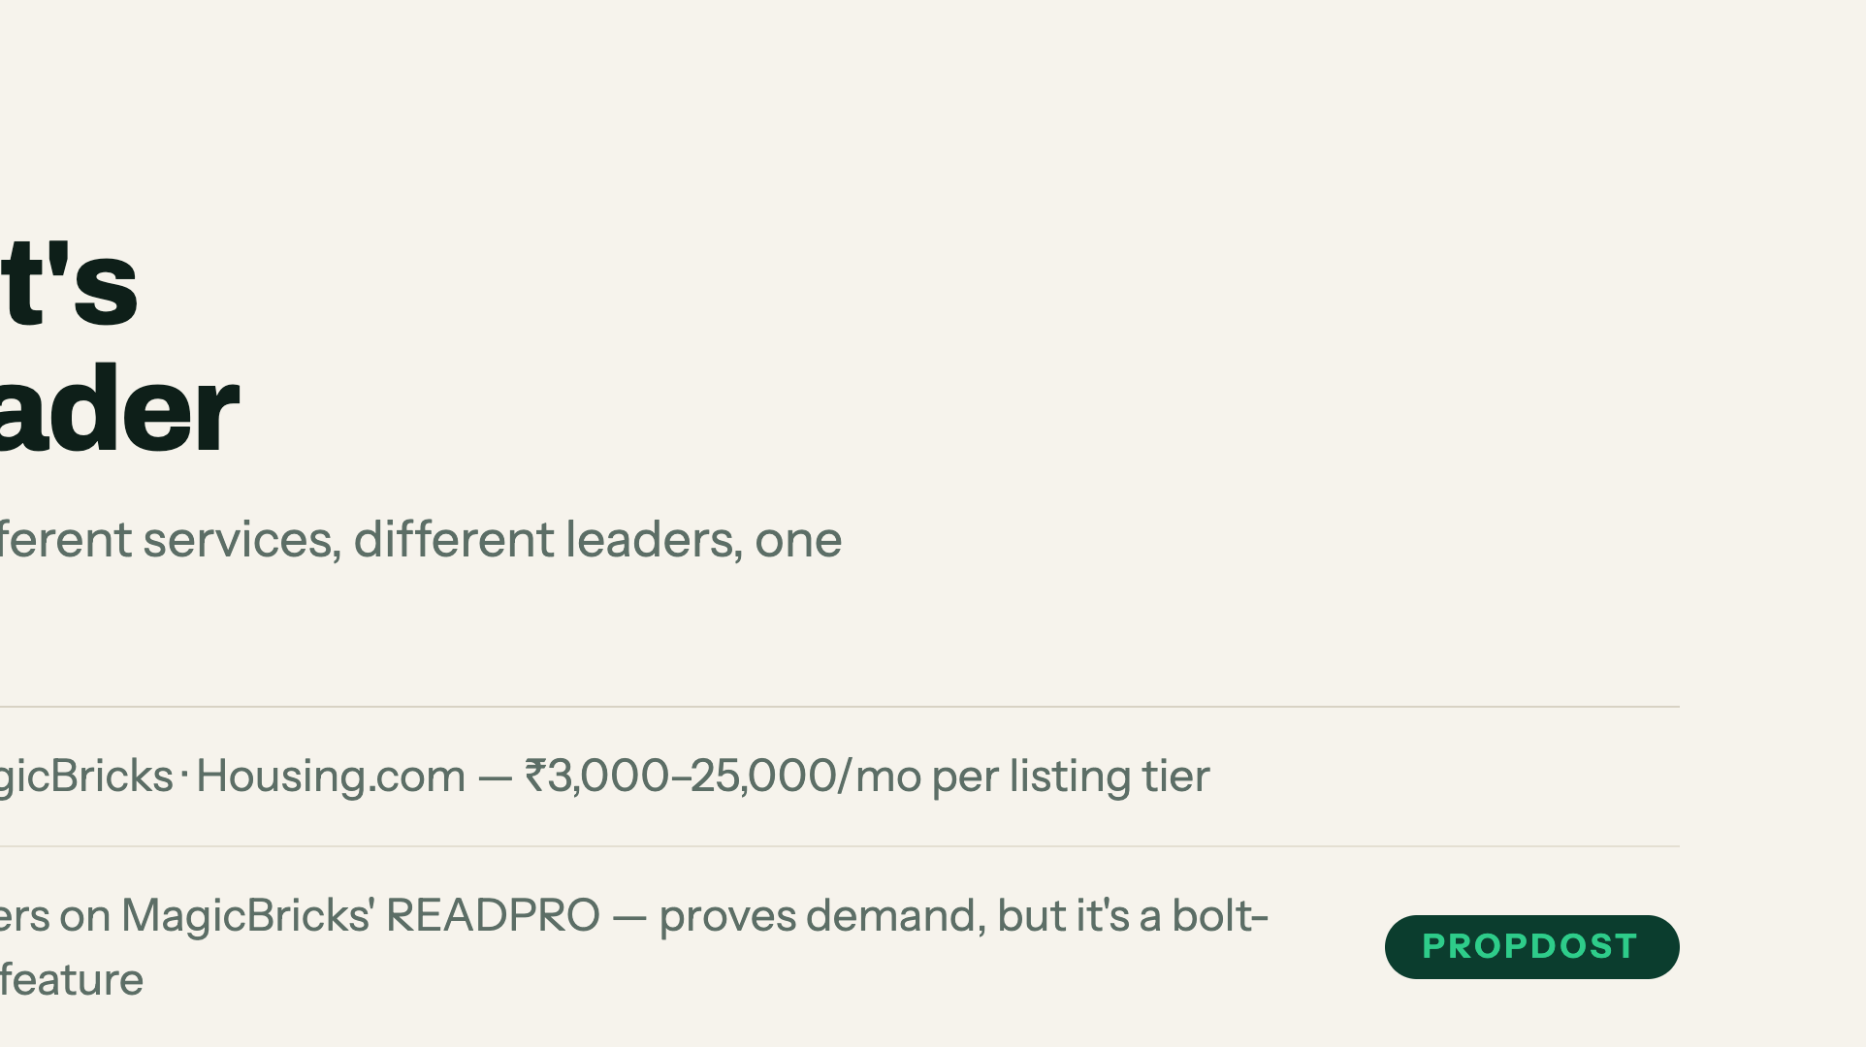
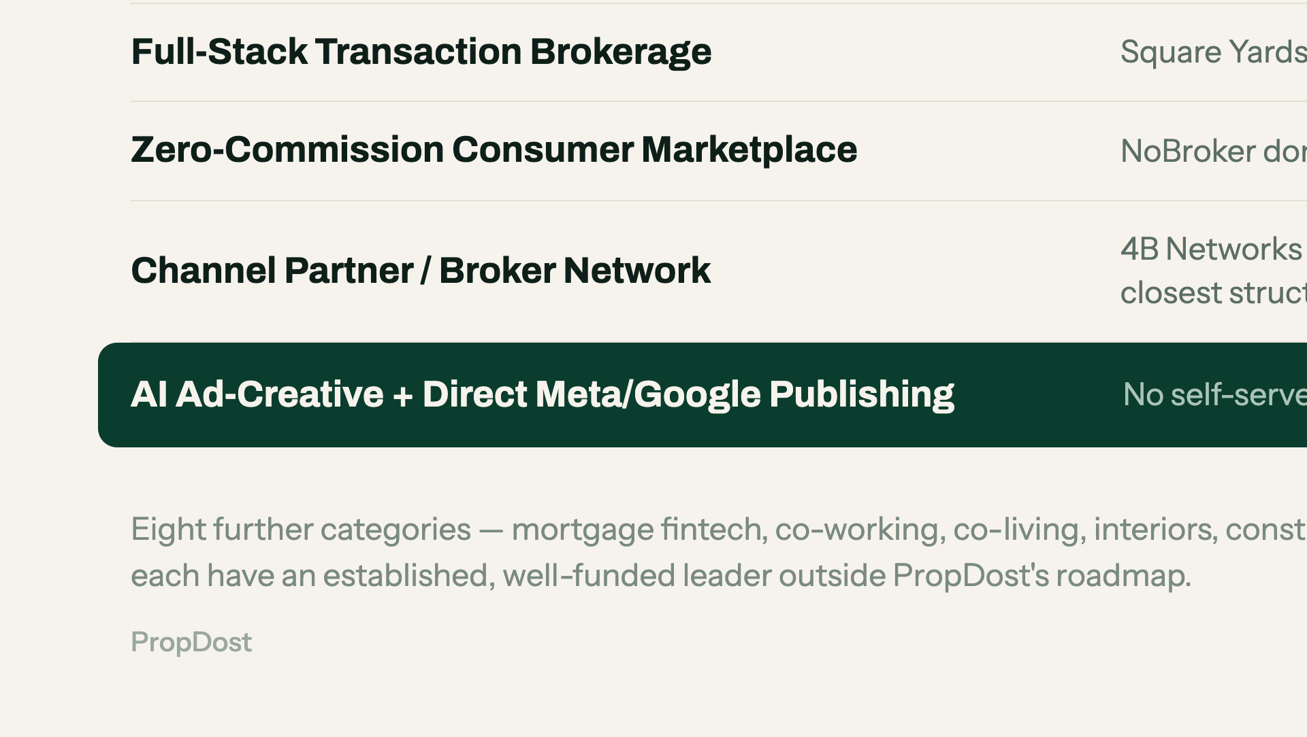
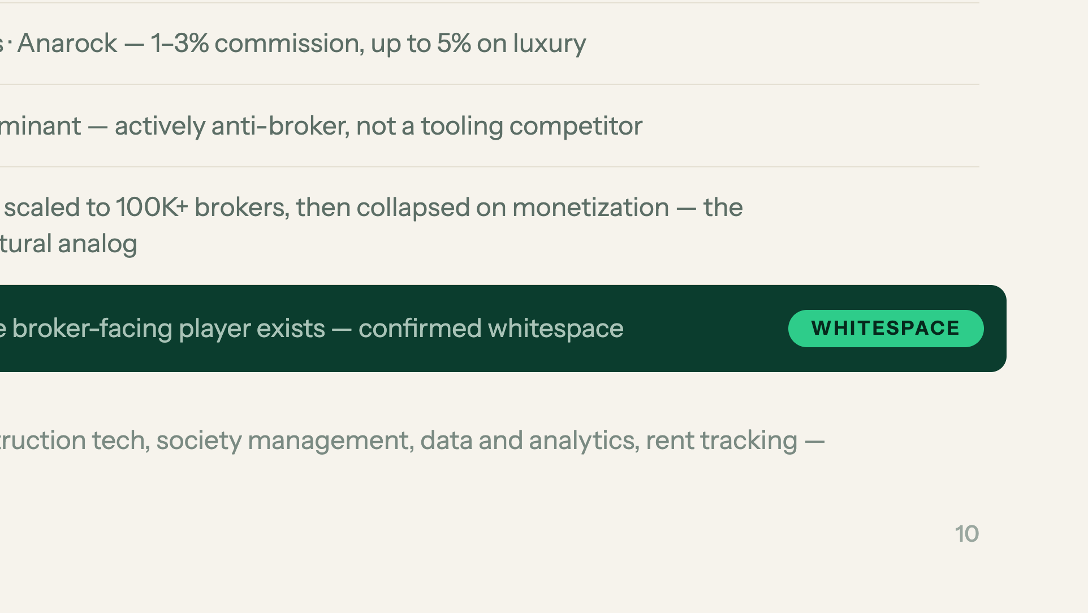
Notes:
PropTech is fourteen markets, not one. The whitespace row is the point — say it and stop.

Slide 11
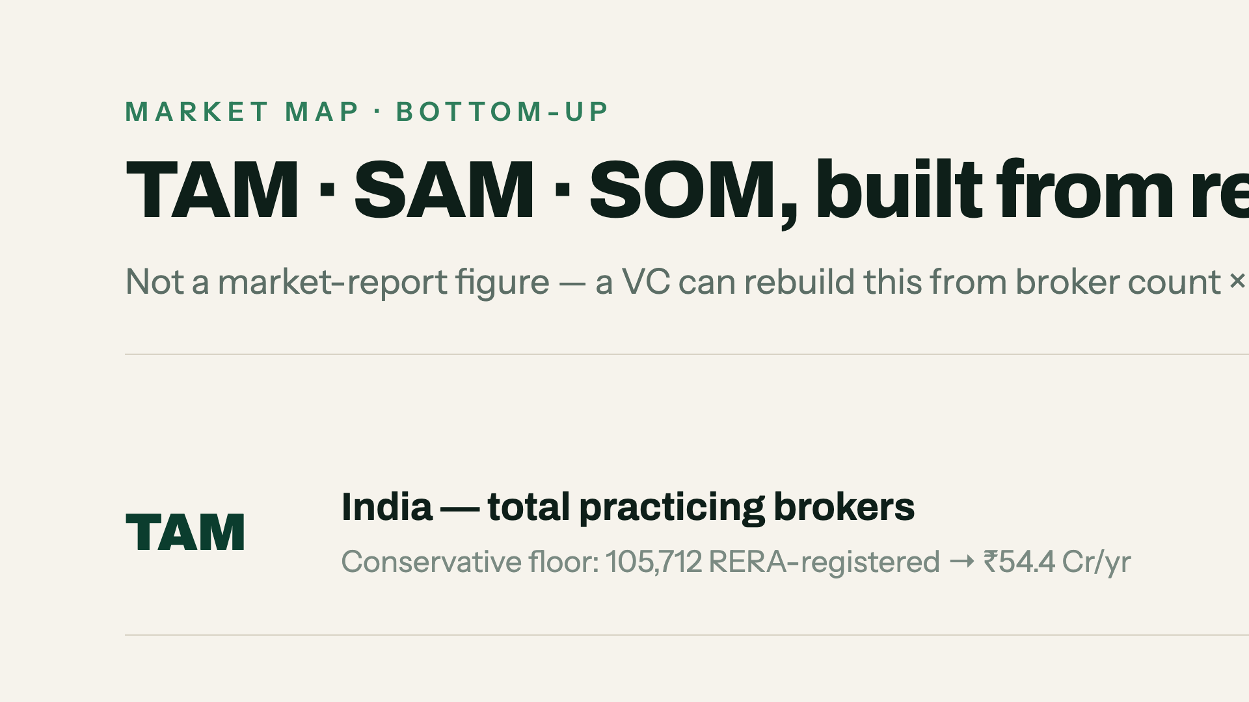
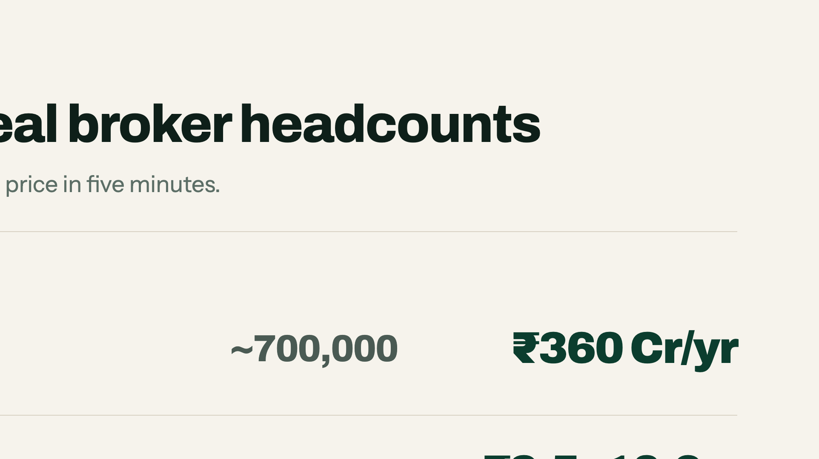
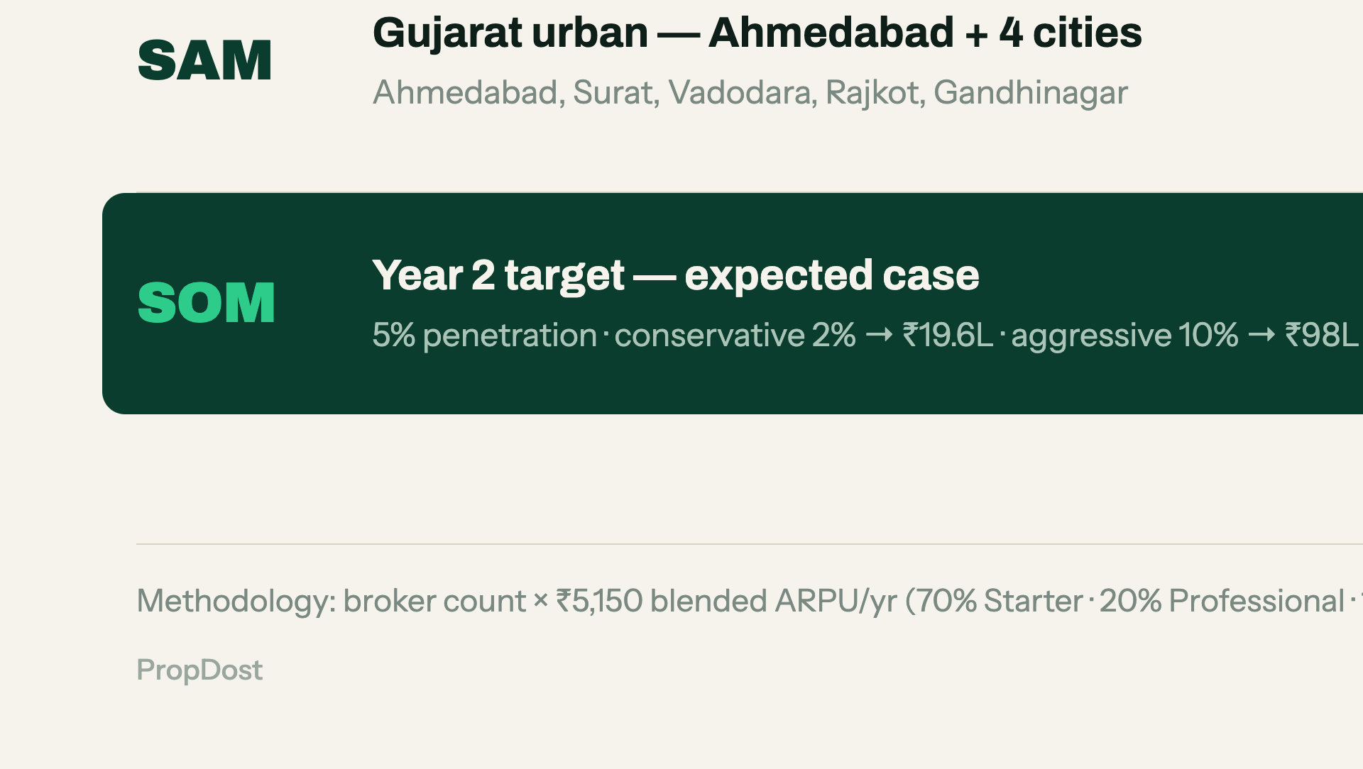
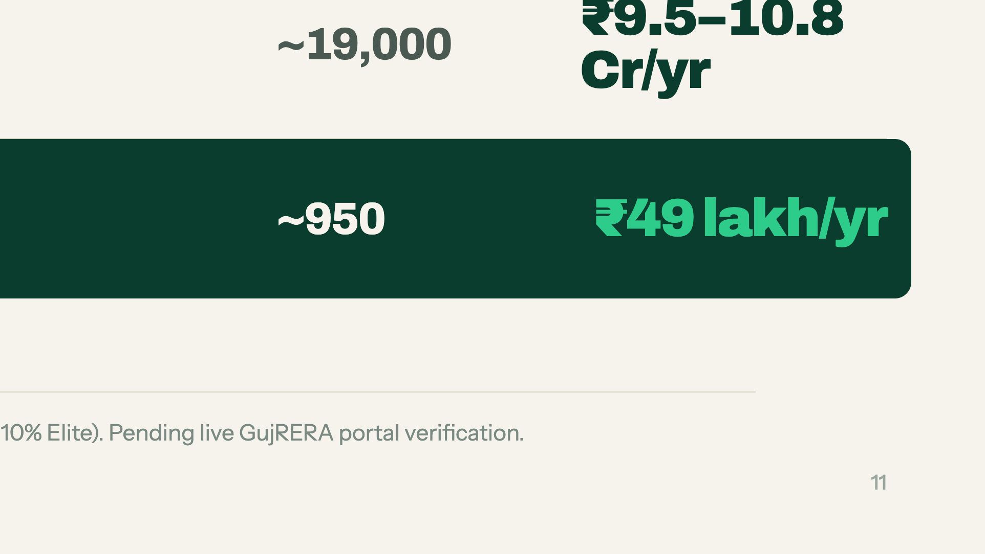
Notes:
A VC can rebuild this in five minutes: broker count times price. Say that line explicitly.

Slide 12
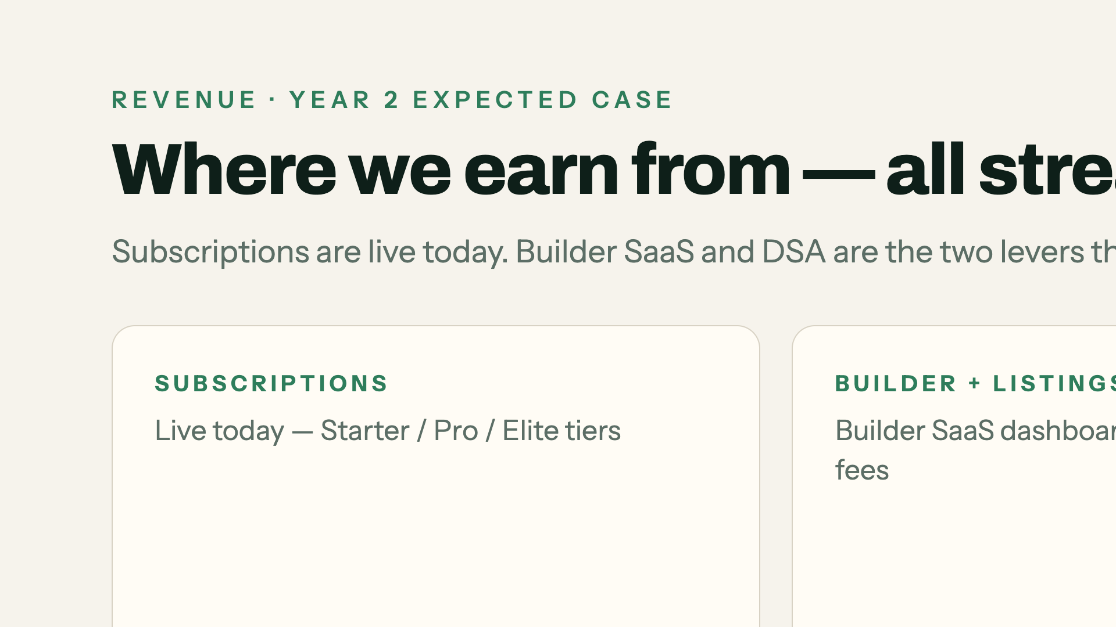
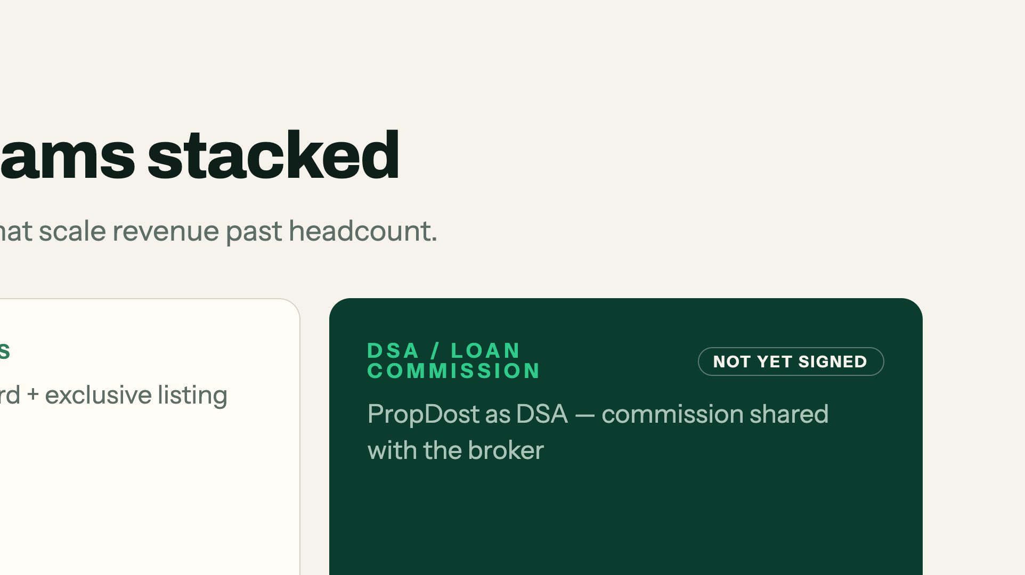
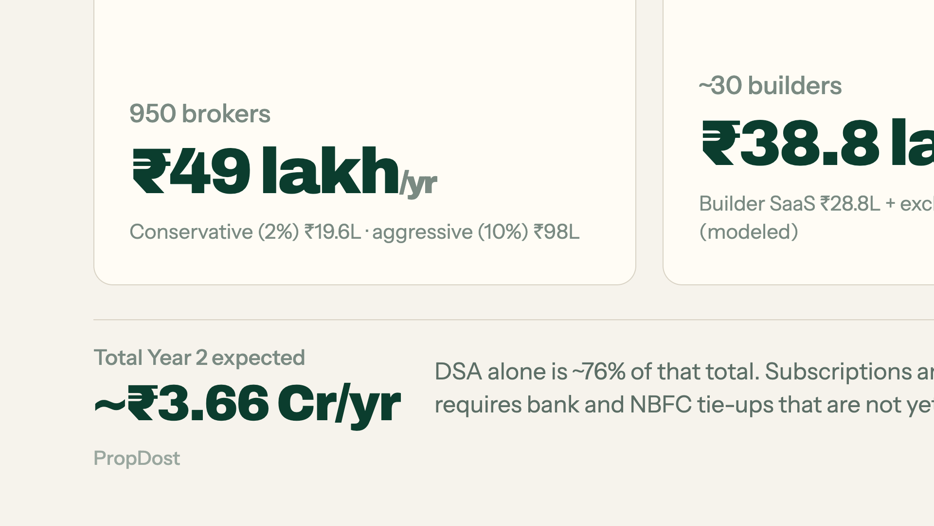
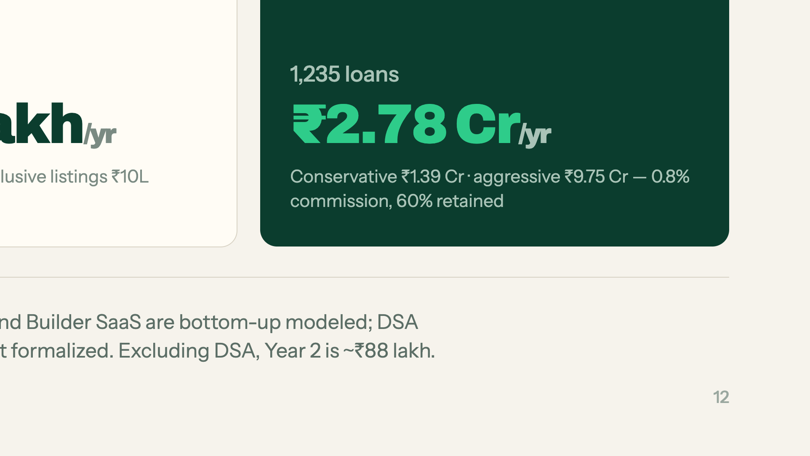
Notes:
Be first to name the DSA concentration — 76% of the total, and the bank tie-ups are not signed. Owning it is stronger than being asked.

Slide 13

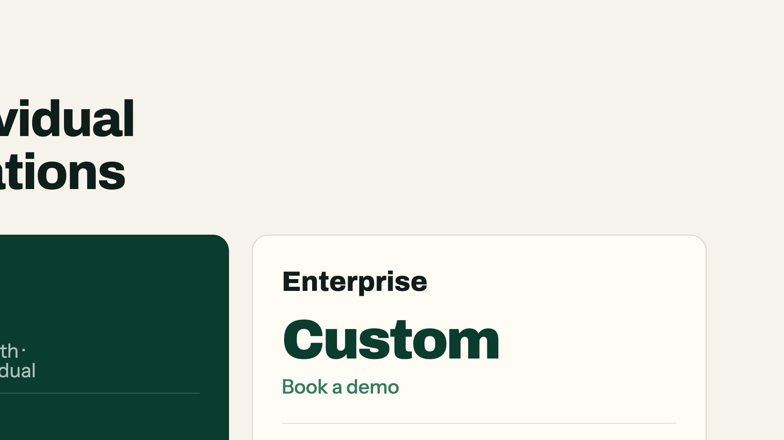
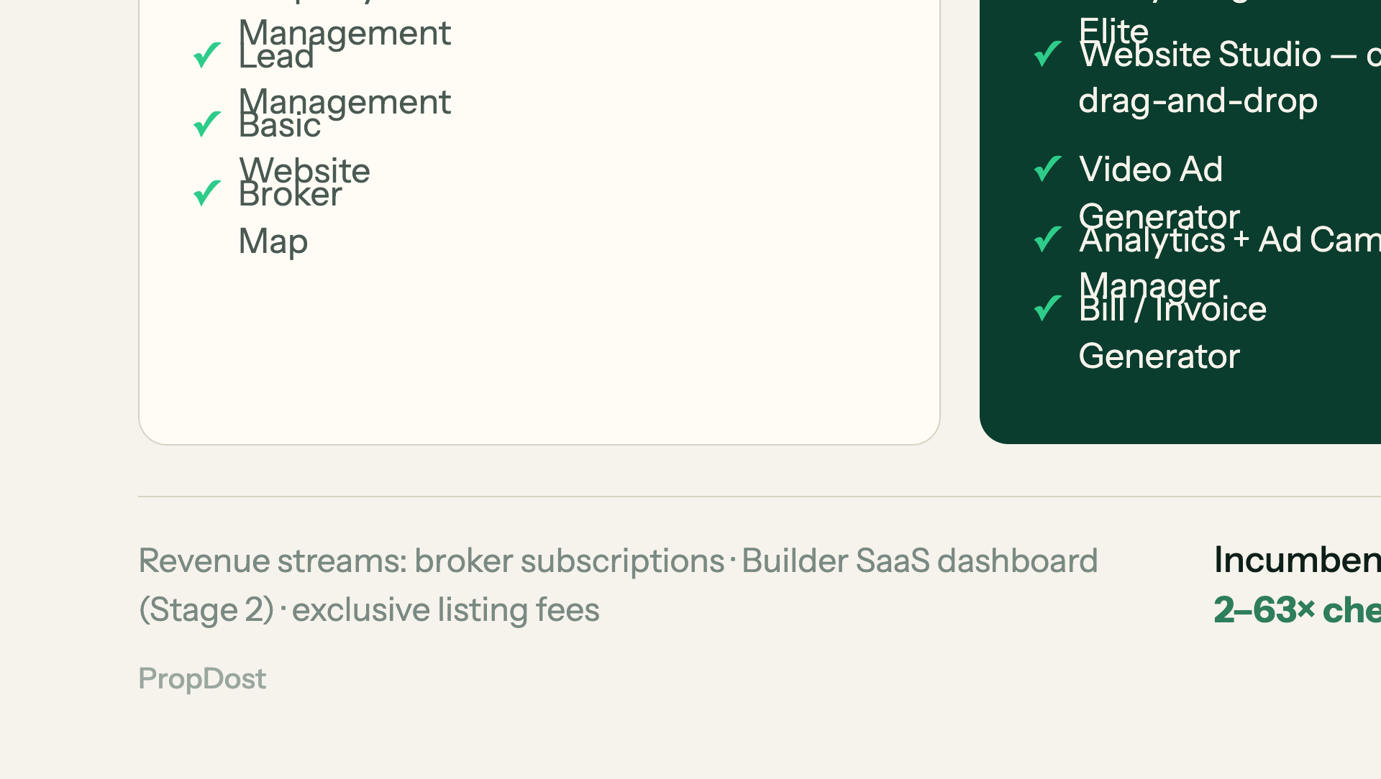
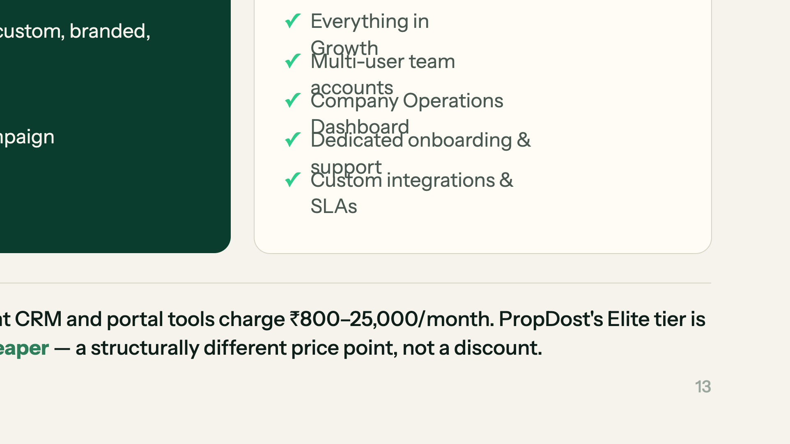
Notes:
Land the 2–63× cheaper line. It is a different price point, not a discount.

Slide 14
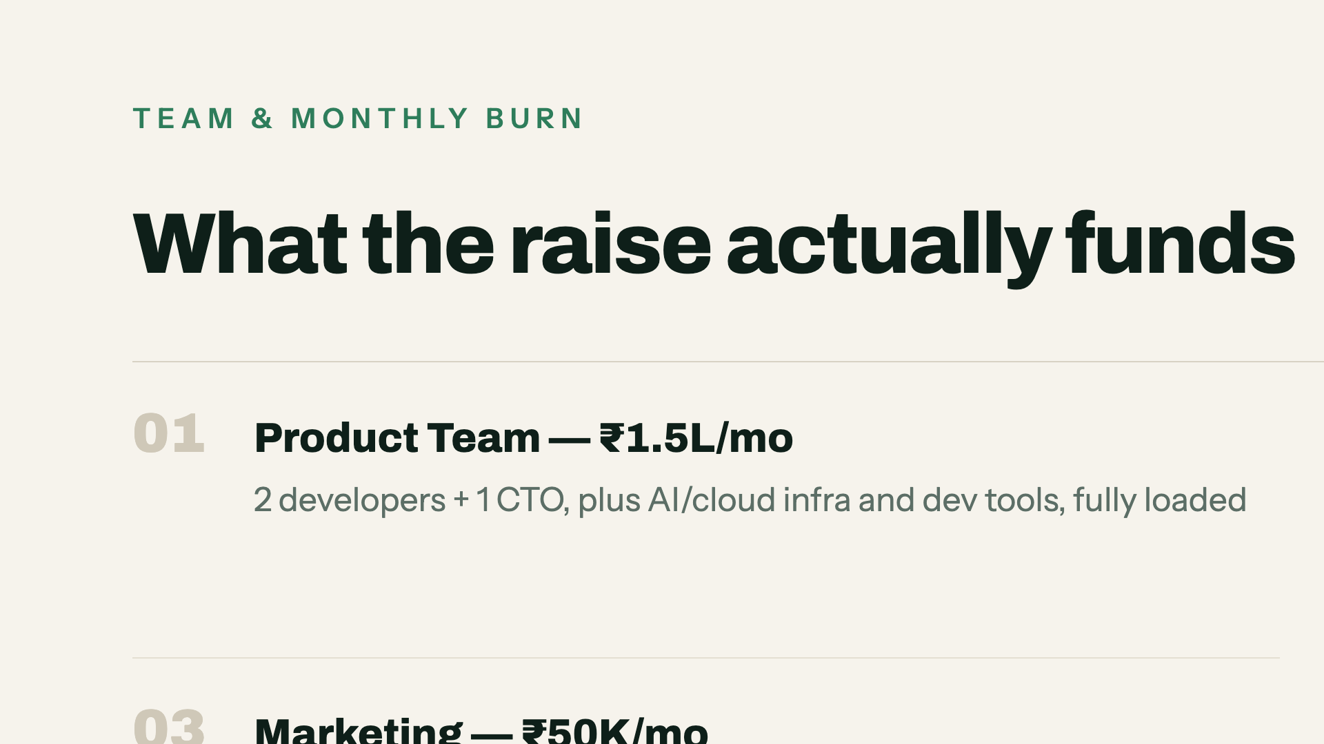
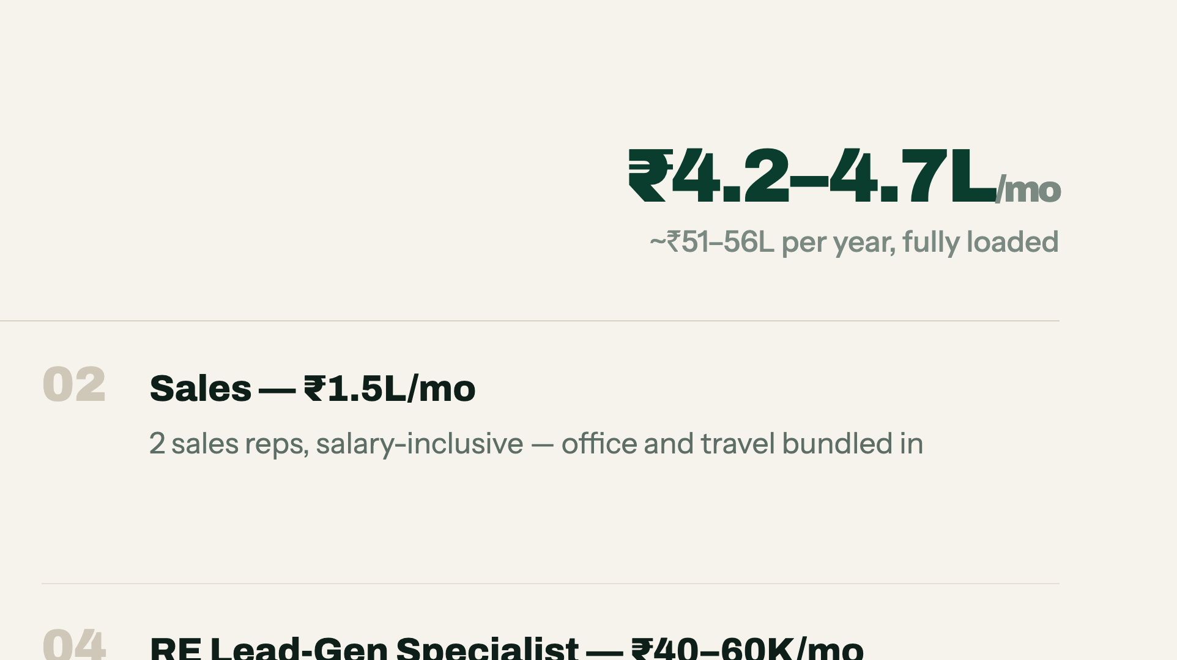
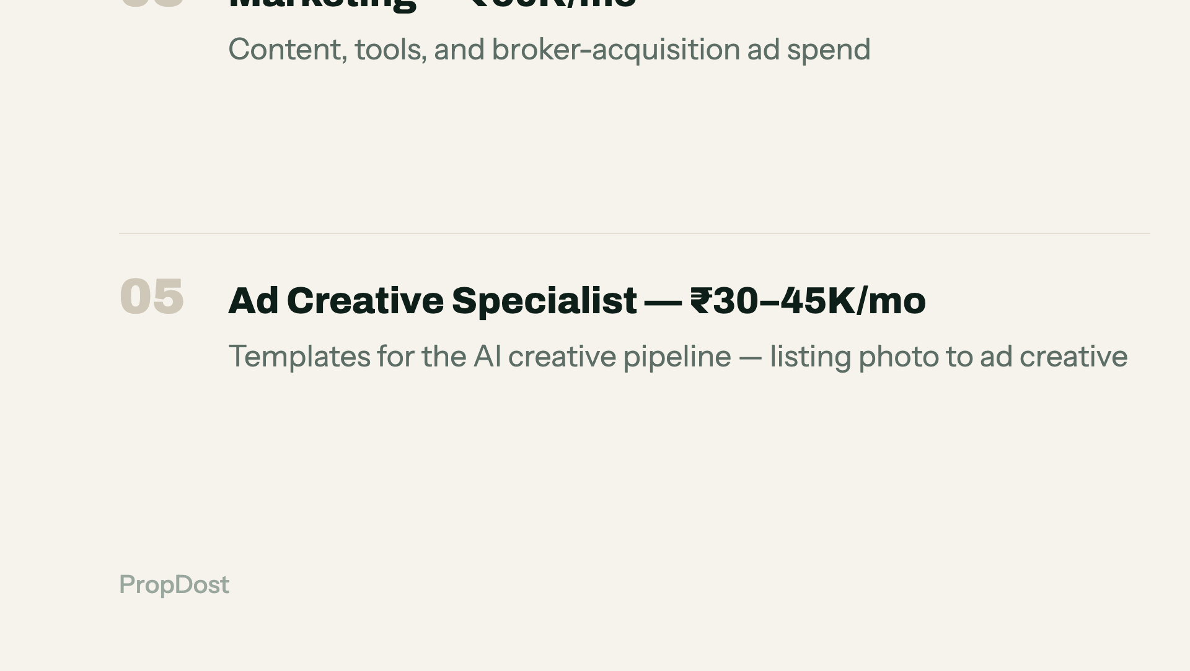

Notes:
₹4.2–4.7L/month. Say the total first, then let them read the lines.

Slide 15




Notes:
Flag these as Stage 2+ hypotheses, not forecasts. Thirty seconds.

Slide 16




Notes:
We are not claiming a slice of a huge market. We are saturating one uncontested region.

Slide 17




Notes:
This is the moat slide. The 22% to 3% dispute number is the proof point — lead with it, then the build sequence.

Slide 18




Notes:
Point at the empty quadrant. Nobody serves the independent broker as the paying customer.

Slide 19




Notes:
Frame ZeProp as validation, not threat. Zero geographic overlap is the line.

Slide 20




Notes:
Do not hide this one. Naming your sharpest competitor and your open diligence item builds more credibility than any claim on the previous slides.

Slide 21
Notes:
Two funded attempts, two trust failures, both inside 18 months. Use this to pre-empt the 'why will you not be 4B Networks' question.

Slide 22
Notes:
Density before breadth. Point 3 — founder-led onboarding for the first 100 — is the one investors test you on.

Slide 23
Notes:
Each stage's customer base funds and feeds the next. This is the scalability argument in one line.

Slide 24
Notes:
Investors anchor here first. Fill in the real paying-broker count and MRR before you present — this slide is weaker than every modeled slide until you do.

Slide 25
Notes:
Six months doing the job. Say it plainly and let the comparison table do the arguing.

Slide 26
Notes:
₹2 Cr pre-seed. State the number, the milestone (2,000 brokers in 18 months), and stop talking.

Slide 27
Notes:
Close on the name. Leave the contact details on screen for questions.

Slide 28
Notes:
Do not present this. It exists so that when someone challenges a number you can turn to it.

